Slide 1
MODULE-3

Slide 2
Relational model concepts
The relational model represents the database as a collection of relations.
Each relation resembles a table of values or, to some extent, a flat file of records. It is called a flat file because each record has a simple linear or flat structure.
When a relation is thought of as a table of values, each row in the table represents a collection of related data values.

Slide 3
A row represents a fact that typically corresponds to a real-world entity or relationship.
The table name and column names are used to help to interpret the meaning of the values in each row.

Slide 4


Slide 5
For example, the first table of Figure is called STUDENT because each row represents facts about a particular student entity.
The column names—Name, Student_number, Class, and Major—specify how to interpret the data values in each row, based on the column each value is in.
All values in a column are of the same data type.
In the formal relational model terminology, a row is called a tuple,
a column header is called an attribute, and the table is called a relation.
The data type describing the types of values that can appear in each column is represented by a domain of possible values. Domain is given name,data type,and format

Slide 6
Domains, Attributes, Tuples, and Relations
A domain D is a set of atomic values.
By atomic we mean that each value in the domain is indivisible as far as the formal relational model is concerned.
Domain is given a name,data type,and format.
Some examples of domains follow:
■ Usa_phone_numbers. The set of ten-digit phone numbers valid in the United States.
■ Local_phone_numbers. The set of seven-digit phone numbers valid within a particular area code in the United States. The use of local phone numbers is quickly becoming obsolete, being replaced by standard ten-digit numbers.

Slide 7
Social_security_numbers. The set of valid nine-digit Social Security numbers.(This is a unique identifier assigned to each person in the United States for employment, tax, and benefits purposes.)
■ Names: The set of character strings that represent names of persons.
■ Grade_point_averages. Possible values of computed grade point averages;each must be a real (floating-point) number between 0 and 4.
■ Employee_ages. Possible ages of employees in a company; each must be an integer value between 15 and 80.
■ Academic_department_names. The set of academic department names in a university, such as Computer Science, Economics, and Physics.
■ Academic_department_codes. The set of academic department codes, such as ‘CS’, ‘ECON’, and ‘PHYS’

Slide 8
A relation schema R, denoted by R(A1, A2, ...,An), is made up of a relation name R and a list of attributes, A1, A2, ..., An.
Each attribute Ai is the name of a role played by some domain D in the relation schema R.
D is called the domain of Ai and is denoted by dom(Ai).
A relation schema is used to describe a relation; R is called the name of this relation.
The degree of a relation is the number of attributes n of its relation schema.
Ex:STUDENT(Name, Ssn, Home_phone, Address, Office_phone, Age, Gpa)
STUDENT(Name: string, Ssn: string, Home_phone: string, Address: string,Office_phone: string, Age: integer, Gpa: real)

Slide 9
A relation (or relation state) r of the relation schema R(A1, A2, ..., An), also denoted by r(R), is a set of n-tuples r = {t1, t2, ..., tm}.
Each n-tuple t is an ordered list of n values
t =<v1, v2, ..., vn>, where each value vi, 1 ≤ i ≤ n, is an element of dom(Ai) or is a special NULL value.
The ith value in tuple t, which corresponds to the attribute Ai, is referred to as t[Ai] or t.Ai (or t[i] if we use the positional notation).
The terms relation intension for the schema R and relation extension for a relation state r(R)
are also commonly used.
NULL values represent attributes whose values are unknown or do not exist.

Slide 10
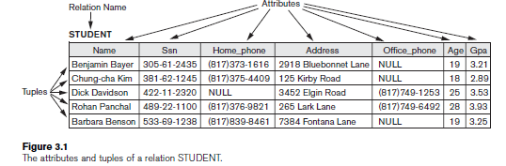
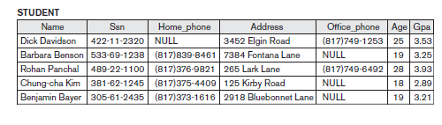

Slide 11
Characteristics of Relations
Ordering of Tuples in a Relation. A relation is defined as a set of tuples.Mathematically, elements of a set have no order among them; hence, tuples in a relation do not have any particular order. when we display a relation as a table, the rows are displayed in a certain order. There is no preference for one ordering over another.

Slide 12
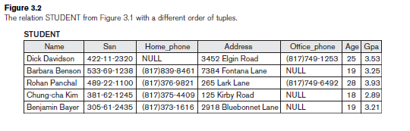

Slide 13
2. Values and NULLs in the Tuples:Each value in a tuple is an atomic value; that is, it is not divisible into components within the framework of the basic relational model.
Much of the theory behind the relational model was developed with this assumption in mind,which is called the first normal form assumption.
In general, we can have several meanings for NULL values, such as value unknown, value exists but is not available, or attribute does not apply to this tuple (also known as value undefined).
a comparison of two NULL values leads to ambiguities

Slide 14
3. Interpretation (Meaning) of a Relation:Each tuple in the relation can then be interpreted as a fact or a particular instance of the assertion.
For example,
the first tuple in Figure 3.1 asserts the fact that there is a STUDENT whose Name is Benjamin Bayer, Ssn is 305-61-2435, Age is 19, and so on

Slide 15
RELATIONAL MODEL CONSTRAINTS

Slide 16
There are generally many restrictions or constraints on the actual values in a database state.
Constraints on databases can generally be divided into three main categories:
1. Constraints that are inherent in the data model. We call these inherent model-based constraints or implicit constraints.(For example, the constraint that a relation cannot have duplicate tuples is an inherent constraint)
2. Constraints that can be directly expressed in schemas of the data model, typically by specifying them in the DDL.We call these schema-based constraints or explicit constraints.

Slide 17
3. Constraints that cannot be directly expressed in the schemas of the data model, and hence must be expressed and enforced by the application programs.We call these application-based or semantic constraints or business rules.
The schema-based constraints include domain constraints, key constraints, constraints on NULLs, entity integrity constraints, and referential integrity constraints.
Domain Constraints:Domain constraints specify that within each tuple, the value of each attribute A must be an atomic value from the domain dom(A).

Slide 18
The data types associated with domains typically include standard numeric data types for integers (such as short integer, integer, and long integer) and real numbers (float and double precision float). Characters, Booleans, fixed-length strings, and variable-length
strings are also available, as are date, time, timestamp, and money, or other special data types.
Key Constraints and Constraints on NULL Values:all tuples in a relation must also be distinct.This means that no two tuples can have the same combination of values for all their attributes.

Slide 19
Suppose that we denote one such subset of attributes by SK; then for any two distinct tuples t1 and t2 in a relation state r of R,
we have the constraint that:t1[SK]≠ t2[SK]
A superkey can have redundant attributes, however, so a more useful concept is that of a key, which has no redundancy.
Hence, a key satisfies two properties:
1. Two distinct tuples in any state of the relation cannot have identical values for (all) the attributes in the key. This first property also applies to a superkey.
2. It is a minimal superkey—that is, a superkey from which we cannot remove any attributes and still have the uniqueness constraint in condition 1 hold.
This property is not required by a superkey.

Slide 20
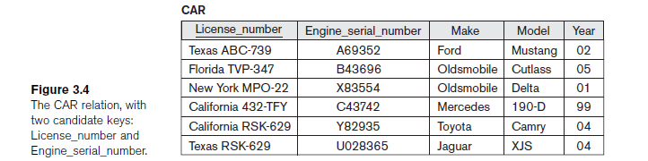

Slide 21
A relation schema may have more than one key. In this case, each of the keys is called a candidate key.
Another constraint on attributes specifies whether NULL values are or are not permitted.
For example, if every STUDENT tuple must have a valid,non-NULL value for the Name attribute, then Name of STUDENT is constrained to be NOT NULL.
Relational Databases and Relational Database Schemas: A relational database schema S is a set of relation schemas S = {R1, R2, ..., Rm} and a set of integrity constraints IC.

Slide 22
A relational database stateDB of S is a set of relation states DB = {r1, r2, ..., rm} such that each ri is a state of Ri and such that the ri relation states satisfy the integrity constraints specified in IC.
A database state that does not obey all the integrity constraints is called an invalid state, and a state that satisfies all the constraints in the defined set of integrity constraints IC is called a valid state.

Slide 23
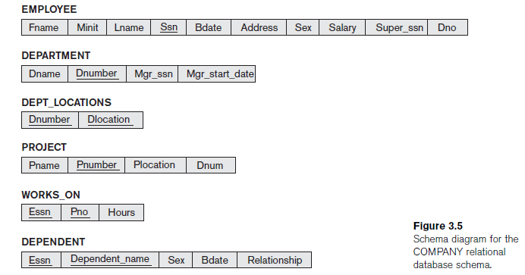

Slide 24
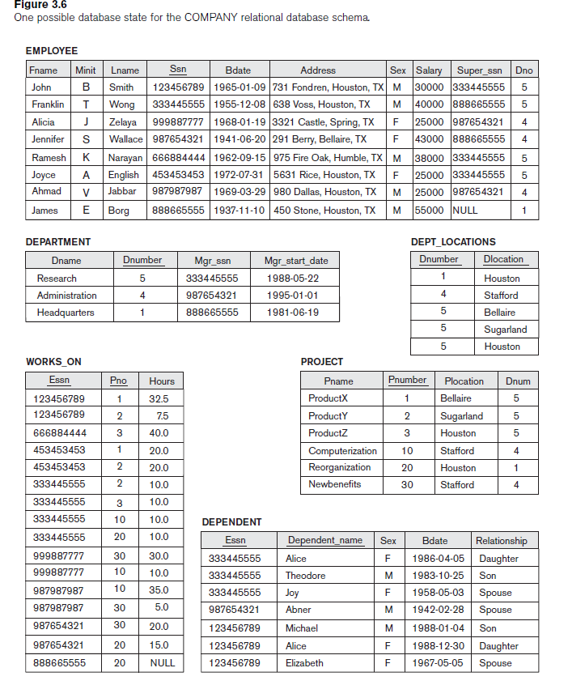

Slide 25
Entity Integrity, Referential Integrity,and Foreign Keys:
The entity integrity constraint states that no primary key value can be NULL. This is because the primary key value is used to identify individual tuples in a relation.
Key constraints and entity integrity constraints are specified on individual relations.
The referential integrity constraint is specified between two relations and is used to maintain the consistency among tuples in the two relations.

Slide 26
To define referential integrity more formally, first we define the concept of a foreign key.
The conditions for a foreign key, given below, specify a referential integrity constraint between the two relation schemas R1 and R2.
A set of attributes FK in relation schema R1 is a foreign key of R1 that references relation R2 if it satisfies the following rules:
1. The attributes in FK have the same domain(s) as the primary key attributes PK of R2; the attributes FK are said to reference or refer to the relation R2.
2. A value of FK in a tuple t1 of the current state r1(R1) either occurs as a value of PK for some tuple t2 in the current state r2(R2) or is NULL. In the former case, we have t1[FK] = t2[PK], and we say that the tuple t1 references or refers to the tuple t2.

Slide 27
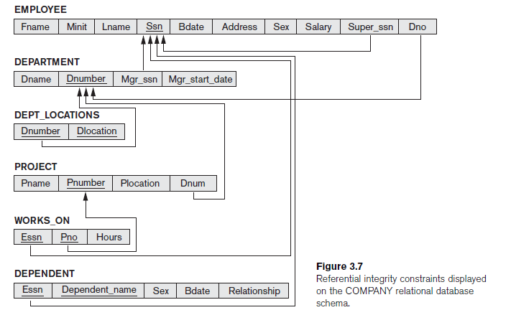

Slide 28
SQL(STRUCTURED QUERY LANGUAGE)
higher-level declarative language interface, so the user only specifies what the result is to be, leaving the actual optimization and decisions on how to execute the query to the DBMS
it is both a DDL and a DML
Non procedural language(what data to retrieve or modify without telling it how to do its job)
SQL does not provide any flow of control constructs,do-loops,if -then-else stataments
SQL provide fixed set of datatypes

Slide 29
DDL-allow you to create,alter,drop schema objects.grant and revoke user privileges and roles.ex:create
DML-Manipulate and query data in the data base.SELECT,INSERT,DELETE,UPDATE
SELECT-Used to retrieve rows of data from table.default-retrieve all rows.
INSERT-insert new rows to table
Delete-delete row from table
UPDATE-change existing data values

Slide 30
The CREATE TABLE Command in SQL
The CREATE TABLE command is used to specify a new relation by giving it a name
and specifying its attributes and initial constraints.
The attributes are specified first,and each attribute is given a name, a data type to specify its domain of values, and any attribute constraints, such as NOT NULL.

Slide 31
SYNTAX:
CREATE TABLE TABLENAME(Attribute1 datatype1 [NOT NULL],…… AttributeN datatype);
EX: CREATE TABLE EMPLOYEE(NAME VARCHAR(15) NOT NULL,ROLLNO INT PRIMARY KEY);
The relations declared through CREATE TABLE statements are called base tables (or base relations); this means that the relation and its tuples are actually created and stored as a file by the DBMS.
In SQL, the attributes in a base table are considered to be ordered in the sequence in which they are specified in the CREATE TABLE statement.
However, rows (tuples) are not considered to be ordered within a relation.

Slide 32
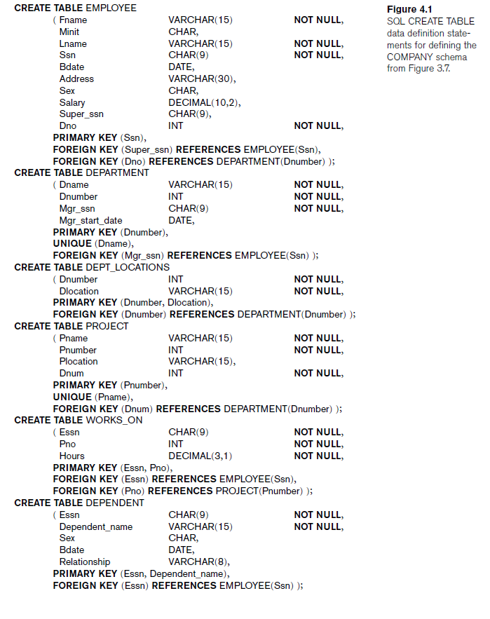

Slide 33
ALTER TABLE AND DROP
Change the structure of a table not its content
Add new column
Increase or decrease the width of an existing column
Specify default value
SYNTAX:
ALTER TABLE table_name ADD(columnspecification|table_ constraint,……);
ALTER TABLE table_name MODIFY(columnspecification|table_ constraint,……);
ALTER TABLE table_name DROP PRIMARY KEY

Slide 34
ALTER TABLE table_name ADD(PRIMARY KEY(ROLLNO));
EX:ALTER TABLE emp MODIFY(fname varchar(60));
ALTER TABLE table_name DROP CONSTRAINT
Constraint_name;

Slide 35
DATA TYPES
The basic data types available for attributes include numeric, character string, bit string, Boolean, date, and time.
1.Numeric data types: include integer numbers of various sizes (INTEGER or INT, and SMALLINT) and floating-point (real) numbers of various precision(FLOAT or REAL, and DOUBLE PRECISION).
Formatted numbers can be declared by using DECIMAL(i,j)—or DEC(i,j) or NUMERIC(i,j)—where i, the, is the total number of decimal digits and j, the scale, is the number of digits after the decimal point.
The default for scale is zero, and the default for precision is implementation-defined.

Slide 36
2.Character-string:
fixed length—CHAR(n) or CHARACTER(n), where n is the number of characters
varying length—VARCHAR(n) or CHAR VARYING(n) or CHARACTER VARYING(n), where n is the maximum number of characters
3. Bit-string data types: are either of fixed length n—BIT(n)
Varying length—BIT VARYING(n), where n is the maximum number of bits.
The default for n, the length of a character string or bit string, is 1.

Slide 37
4. A Boolean data type: has the traditional values of TRUE or FALSE. In SQL, because of the presence of NULL values, a three-valued logic is used UNKNOWN.
5.The DATE data type has ten positions, and its components are YEAR,MONTH, and DAY in the form YYYY-MM-DD.
The TIME data type has at least eight positions, with the components HOUR, MINUTE, and SECOND in the form HH:MM:SS.

Slide 38
Basic Retrieval Queries in SQL
1. The SELECT-FROM-WHERE Structure of Basic SQL Queries:
SELECT <attribute list>
FROM <table list>
WHERE <condition>;
where
■ <attribute list> is a list of attribute names whose values are to be retrieved by
the query.
■ <table list> is a list of the relation names required to process the query.
■ <condition> is a conditional (Boolean) expression that identifies the tuples to be retrieved by the query.

Slide 39
Simple SQL Queries
Basic SQL queries correspond to using the SELECT, PROJECT, and JOIN operations of the relational algebra
All subsequent examples use the COMPANY database
Example of a simple query on one relation
Query 0: Retrieve the birthdate and address of the employee whose name is 'John B. Smith'.
Q0: SELECT BDATE, ADDRESS FROM EMPLOYEE WHERE FNAME='John' AND MINIT='B’ AND LNAME='Smith’
Similar to a SELECT-PROJECT pair of relational algebra operations; the SELECT-clause specifies the projection attributes and the WHERE-clause specifies the selection condition
However, the result of the query may contain duplicate tuples

Slide 40
Simple SQL Queries (cont.)
Query 1: Retrieve the name and address of all employees who work for the 'Research' department.
Q1: SELECT FNAME, LNAME, ADDRESS FROM EMPLOYEE, DEPARTMENT WHERE DNAME='Research' AND DNUMBER=DNO
Similar to a SELECT-PROJECT-JOIN sequence of relational algebra operations
(DNAME='Research') is a selection condition (corresponds to a SELECT operation in relational algebra)
(DNUMBER=DNO) is a join condition (corresponds to a JOIN operation in relational algebra)

Slide 41
Simple SQL Queries (cont.)
Query 2: For every project located in 'Stafford', list the project number, the controlling department number, and the department manager's last name, address, and birthdate.
Q2: SELECT PNUMBER, DNUM, LNAME, BDATE, ADDRESS FROM PROJECT, DEPARTMENT, EMPLOYEE WHERE DNUM=DNUMBER AND MGRSSN=SSN AND PLOCATION='Stafford'
In Q2, there are two join conditions
The join condition DNUM=DNUMBER relates a project to its controlling department
The join condition MGRSSN=SSN relates the controlling department to the employee who manages that department

Slide 42
Aliases, * and DISTINCT, Empty WHERE-clause
In SQL, we can use the same name for two (or more) attributes as long as the attributes are in different relations A query that refers to two or more attributes with the same name must qualify the attribute name with the relation name by prefixing the relation name to the attribute name
Example:
EMPLOYEE.LNAME, DEPARTMENT.DNAME

Slide 43
ALIASES
Some queries need to refer to the same relation twice
In this case, aliases are given to the relation name
Query 8: For each employee, retrieve the employee's name, and the name of his or her immediate supervisor. Q8: SELECT E.FNAME, E.LNAME, S.FNAME, S.LNAME FROM EMPLOYEE E S WHERE E.SUPERSSN=S.SSN
In Q8, the alternate relation names E and S are called aliases or tuple variables for the EMPLOYEE relation
We can think of E and S as two different copies of EMPLOYEE; E represents employees in role of supervisees and S represents employees in role of supervisors

Slide 44
ALIASES (cont.)
Aliasing can also be used in any SQL query for convenience Can also use the AS keyword to specify aliases Q8: SELECT E.FNAME, E.LNAME, S.FNAME, S.LNAME
FROM EMPLOYEE AS E, EMPLOYEE AS S
WHERE E.SUPERSSN=S.SSN

Slide 45
UNSPECIFIED WHERE-clause
A missing WHERE-clause indicates no condition; hence, all tuples of the relations in the FROM-clause are selected
This is equivalent to the condition WHERE TRUE
Query 9: Retrieve the SSN values for all employees.
Q9: SELECT SSN FROM EMPLOYEE
If more than one relation is specified in the FROM-clause and there is no join condition, then the CARTESIAN PRODUCT of tuples is selected

Slide 46
UNSPECIFIED WHERE-clause (cont.)
Example: Q10: SELECT SSN, DNAME FROM EMPLOYEE, DEPARTMENT
It is extremely important not to overlook specifying any selection and join conditions in the WHERE-clause; otherwise, incorrect and very large relations may result

Slide 47
USE OF *
To retrieve all the attribute values of the selected tuples, a * is used, which stands for all the attributes Examples:
Q1C: SELECT * FROM EMPLOYEE WHERE DNO=5 Q1D: SELECT * FROM EMPLOYEE, DEPARTMENT WHERE DNAME='Research' AND DNO=DNUMBER

Slide 48
USE OF DISTINCT
SQL does not treat a relation as a set; duplicate tuples can appear
To eliminate duplicate tuples in a query result, the keyword DISTINCT is used
For example, the result of Q11 may have duplicate SALARY values whereas Q11A does not have any duplicate values
Q11: SELECT SALARY FROM EMPLOYEE Q11A: SELECT DISTINCT SALARY FROM EMPLOYEE

Slide 49
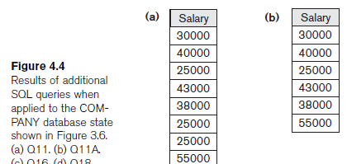

Slide 50
SET OPERATIONS
SQL has directly incorporated some set operations
There is a union operation (UNION), and in some versions of SQL there are set difference (MINUS) and intersection (INTERSECT) operations
The resulting relations of these set operations are sets of tuples; duplicate tuples are eliminated from the result
The set operations apply only to union compatible relations ; the two relations must have the same attributes and the attributes must appear in the same order

Slide 51
SET OPERATIONS (cont.)
Query 4: Make a list of all project numbers for projects that involve an employee whose last name is 'Smith' as a worker or as a manager of the department that controls the project. Q4: (SELECT PNAME FROM PROJECT, DEPARTMENT, EMPLOYEE WHERE DNUM=DNUMBER AND MGRSSN=SSN AND LNAME='Smith') UNION (SELECT PNAME FROM PROJECT, WORKS_ON, EMPLOYEE WHERE PNUMBER=PNO AND ESSN=SSN AND LNAME='Smith')

Slide 52
NESTING OF QUERIES
A complete SELECT query, called a nested query , can be specified within the WHERE-clause of another query, called the outer query
Many of the previous queries can be specified in an alternative form using nesting
Query 1: Retrieve the name and address of all employees who work for the 'Research' department. Q1: SELECT FNAME, LNAME, ADDRESS FROM EMPLOYEE WHERE DNO IN (SELECT DNUMBER FROM DEPARTMENT WHERE DNAME='Research' )

Slide 53
NESTING OF QUERIES (cont.)
The nested query selects the number of the 'Research' department
The outer query select an EMPLOYEE tuple if its DNO value is in the result of either nested query
The comparison operator IN compares a value v with a set (or multi-set) of values V, and evaluates to TRUE if v is one of the elements in V
In general, we can have several levels of nested queries
A reference to an unqualified attribute refers to the relation declared in the innermost nested query
In this example, the nested query is not correlated with the outer query

Slide 54
CORRELATED NESTED QUERIES
If a condition in the WHERE-clause of a nested query references an attribute of a relation declared in the outer query , the two queries are said to be correlated
The result of a correlated nested query is different for each tuple (or combination of tuples) of the relation(s) the outer query
Query 12: Retrieve the name of each employee who has a dependent with the same first name as the employee. Q12: SELECT E.FNAME, E.LNAME FROM EMPLOYEE AS E WHERE E.SSN IN (SELECT ESSN FROM DEPENDENT WHERE ESSN=E.SSN AND E.FNAME=DEPENDENT_NAME)

Slide 55
CORRELATED NESTED QUERIES (cont.)
In Q12, the nested query has a different result for each tuple in the outer query
A query written with nested SELECT... FROM... WHERE... blocks and using the = or IN comparison operators can always be expressed as a single block query. For example, Q12 may be written as in Q12A Q12A: SELECT E.FNAME, E.LNAME FROM EMPLOYEE E, DEPENDENT D WHERE E.SSN=D.ESSN AND E.FNAME=D.DEPENDENT_NAME
The original SQL as specified for SYSTEM R also had a CONTAINS comparison operator, which is used in conjunction with nested correlated queries
This operator was dropped from the language, possibly because of the difficulty in implementing it efficiently

Slide 56
CORRELATED NESTED QUERIES (cont.)
Most implementations of SQL do not have this operator
The CONTAINS operator compares two sets of values , and returns TRUE if one set contains all values in the other set (reminiscent of the division operation of algebra).
Query 3: Retrieve the name of each employee who works on all the projects controlled by department number 5. Q3: SELECT FNAME, LNAME FROM EMPLOYEE WHERE ( (SELECT PNO FROM WORKS_ON WHERE SSN=ESSN) CONTAINS (SELECT PNUMBER FROM PROJECT WHERE DNUM=5) )

Slide 57
CORRELATED NESTED QUERIES (cont.)
In Q3, the second nested query, which is not correlated with the outer query, retrieves the project numbers of all projects controlled by department 5
The first nested query, which is correlated, retrieves the project numbers on which the employee works, which is different for each employee tuple because of the correlation

Slide 58
THE EXISTS FUNCTION
EXISTS is used to check whether the result of a correlated nested query is empty (contains no tuples) or not
We can formulate Query 12 in an alternative form that uses EXISTS as Q12B below

Slide 59
THE EXISTS FUNCTION (cont.)
Query 12: Retrieve the name of each employee who has a dependent with the same first name as the employee. Q12B: SELECT FNAME, LNAME FROM EMPLOYEE WHERE EXISTS (SELECT * FROM DEPENDENT WHERE SSN=ESSN AND FNAME=DEPENDENT_NAME)

Slide 60
THE EXISTS FUNCTION (cont.)
Query 6: Retrieve the names of employees who have no dependents. Q6: SELECT FNAME, LNAME FROM EMPLOYEE WHERE NOT EXISTS (SELECT * FROM DEPENDENT WHERE SSN=ESSN)
In Q6, the correlated nested query retrieves all DEPENDENT tuples related to an EMPLOYEE tuple. If none exist , the EMPLOYEE tuple is selected
EXISTS is necessary for the expressive power of SQL

Slide 61
EXPLICIT SETS
It is also possible to use an explicit (enumerated) set of values in the WHERE-clause rather than a nested query
Query 13: Retrieve the social security numbers of all employees who work on project number 1, 2, or 3.
Q13: SELECT DISTINCT ESSN FROM WORKS_ON WHERE PNO IN (1, 2, 3)

Slide 62
NULLS IN SQL QUERIES
SQL allows queries that check if a value is NULL (missing or undefined or not applicable)
SQL uses IS or IS NOT to compare NULLs because it considers each NULL value distinct from other NULL values, so equality comparison is not appropriate .
Query 14: Retrieve the names of all employees who do not have supervisors. Q14: SELECT FNAME, LNAME FROM EMPLOYEE WHERE SUPERSSN IS NULL Note: If a join condition is specified, tuples with NULL values for the join attributes are not included in the result

Slide 63
BETWEEN
Query 14. Retrieve all employees in department 5 whose salary is between $30,000 and $40,000.
Q14: SELECT * FROM EMPLOYEE WHERE (Salary BETWEEN 30000 AND 40000) AND Dno = 5; OR
SELECT * FROM EMPLOYEE WHERE((Salary >= 30000) AND (Salary <= 40000)) AND Dno = 5;

Slide 64
AGGREGATE FUNCTIONS
Include COUNT, SUM, MAX, MIN, and AVG
Query 15: Find the maximum salary, the minimum salary, and the average salary among all employees. Q15: SELECT MAX(SALARY), MIN(SALARY), AVG(SALARY) FROM EMPLOYEE
Some SQL implementations may not allow more than one function in the SELECT-clause

Slide 65
AGGREGATE FUNCTIONS (cont.)
Query 16: Find the maximum salary, the minimum salary, and the average salary among employees who work for the 'Research' department. Q16: SELECT MAX(SALARY), MIN(SALARY), AVG(SALARY) FROM EMPLOYEE, DEPARTMENT WHERE DNO=DNUMBER AND DNAME='Research'

Slide 66
AGGREGATE FUNCTIONS (cont.)
Queries 17 and 18: Retrieve the total number of employees in the company (Q17), and the number of employees in the 'Research' department (Q18). Q17: SELECT COUNT (*) FROM EMPLOYEE Q18: SELECT COUNT (*) FROM EMPLOYEE, DEPARTMENT WHERE DNO=DNUMBER AND DNAME='Research’

Slide 67
ORDER BY
SQL allows the user to order the tuples in the result of a query by the values of one or more of the attributes that appear in the query result, by using the ORDER BY clause.
SELECT <attribute list> FROM <table list> [ WHERE <condition> ]
[ ORDER BY <attribute list> ];
SELECT Fname,Lname FROM EMPLOYEE WHERE Dno=5 ORDER BY Fname;
The default order is in ascending order of values.We can specify the keyword DESC if we want to see the result in a descending order of values.
The keyword ASC can be used to specify ascending order explicitly.

Slide 68
ORDER BY
The ORDER BY clause is used to sort the tuples in a query result based on the values of some attribute(s)
Query 28: Retrieve a list of employees and the projects each works in, ordered by the employee's department, and within each department ordered alphabetically by employee last name. Q28: SELECT DNAME, LNAME, FNAME, PNAME FROM DEPARTMENT, EMPLOYEE, WORKS_ON, PROJECT WHERE DNUMBER=DNO AND SSN=ESSN AND PNO=PNUMBER ORDER BY DNAME, LNAME

Slide 69
GROUPING
In many cases, we want to apply the aggregate functions to subgroups of tuples in a relation
Each subgroup of tuples consists of the set of tuples that have the same value for the grouping attribute(s)
The function is applied to each subgroup independently
SQL has a GROUP BY-clause for specifying the grouping attributes, which must also appear in the SELECT-clause

Slide 70
GROUPING (cont.)
Query 20: For each department, retrieve the department number, the number of employees in the department, and their average salary. Q20: SELECT DNO, COUNT (*), AVG (SALARY) FROM EMPLOYEE GROUP BY DNO
In Q20, the EMPLOYEE tuples are divided into groups--each group having the same value for the grouping attribute DNO
The COUNT and AVG functions are applied to each such group of tuples separately
The SELECT-clause includes only the grouping attribute and the functions to be applied on each group of tuples
A join condition can be used in conjunction with grouping

Slide 71
GROUPING (cont.)
Query 21: For each project, retrieve the project number, project name, and the number of employees who work on that project. Q21: SELECT PNUMBER, PNAME, COUNT (*) FROM PROJECT, WORKS_ON WHERE PNUMBER=PNO GROUP BY PNUMBER, PNAME
In this case, the grouping and functions are applied after the joining of the two relations

Slide 72
THE HAVING-CLAUSE
Sometimes we want to retrieve the values of these functions for only those groups that satisfy certain conditions
The HAVING-clause is used for specifying a selection condition on groups (rather than on individual tuples)

Slide 73
THE HAVING-CLAUSE (cont.)
Query 22: For each project on which more than two employees work , retrieve the project number, project name, and the number of employees who work on that project. Q22: SELECT PNUMBER, PNAME, COUNT (*) FROM PROJECT, WORKS_ON WHERE PNUMBER=PNO GROUP BY PNUMBER, PNAME HAVING COUNT (*) > 2

Slide 74
SUBSTRING COMPARISON
The LIKE comparison operator is used to compare partial strings
Two reserved characters are used: '%' (or '*' in some implementations) replaces an arbitrary number of characters, and '_' replaces a single arbitrary character

Slide 75
SUBSTRING COMPARISON (cont.)
Query 25: Retrieve all employees whose address is in Houston, Texas. Here, the value of the ADDRESS attribute must contain the substring 'Houston,TX'. Q25: SELECT FNAME, LNAME FROM EMPLOYEE WHERE ADDRESS LIKE '%Houston,TX%’

Slide 76
SUBSTRING COMPARISON (cont.)
Query 26: Retrieve all employees who were born during the 1950s. Here, '5' must be the 8th character of the string (according to our format for date), so the BDATE value is '_______5_', with each underscore as a place holder for a single arbitrary character. Q26: SELECT FNAME, LNAME FROM EMPLOYEE WHERE BDATE LIKE '_______5_’
The LIKE operator allows us to get around the fact that each value is considered atomic and indivisible; hence, in SQL, character string attribute values are not atomic

Slide 77
ARITHMETIC OPERATIONS
The standard arithmetic operators '+', '-'. '*', and '/' (for addition, subtraction, multiplication, and division, respectively) can be applied to numeric values in an SQL query result
Query 27: Show the effect of giving all employees who work on the 'ProductX' project a 10% raise. Q27: SELECT FNAME, LNAME, 1.1*SALARY FROM EMPLOYEE, WORKS_ON, PROJECT WHERE SSN=ESSN AND PNO=PNUMBER AND PNAME='ProductX’

Slide 78
Summary of SQL Queries
A query in SQL can consist of up to six clauses, but only the first two, SELECT and FROM, are mandatory. The clauses are specified in the following order: SELECT <attribute list> FROM <table list> [WHERE <condition>] [GROUP BY <grouping attribute(s)>] [HAVING <group condition>] [ORDER BY <attribute list>]

Slide 79
Summary of SQL Queries (cont.)
The SELECT-clause lists the attributes or functions to be retrieved
The FROM-clause specifies all relations (or aliases) needed in the query but not those needed in nested queries
The WHERE-clause specifies the conditions for selection and join of tuples from the relations specified in the FROM-clause
GROUP BY specifies grouping attributes
HAVING specifies a condition for selection of groups
ORDER BY specifies an order for displaying the result of a query
A query is evaluated by first applying the WHERE-clause, then GROUP BY and HAVING, and finally the SELECT-clause

Slide 80
Specifying Updates in SQL
There are three SQL commands to modify the database; INSERT, DELETE, and UPDATE

Slide 81
INSERT
In its simplest form, it is used to add one or more tuples to a relation
Attribute values should be listed in the same order as the attributes were specified in the CREATE TABLE command

Slide 82
INSERT (cont.)
Example: U1: INSERT INTO EMPLOYEE VALUES ('Richard','K','Marini', '653298653', '30-DEC-52', '98 Oak Forest,Katy,TX', 'M', 37000,'987654321', 4 )
An alternate form of INSERT specifies explicitly the attribute names that correspond to the values in the new tuple
Attributes with NULL values can be left out
Example: Insert a tuple for a new EMPLOYEE for whom we only know the FNAME, LNAME, and SSN attributes. U1A: INSERT INTO EMPLOYEE (FNAME, LNAME, SSN) VALUES ('Richard', 'Marini', '653298653')

Slide 83
INSERT (cont.)
Important Note: Only the constraints specified in the DDL commands are automatically enforced by the DBMS when updates are applied to the database
Another variation of INSERT allows insertion of multiple tuples resulting from a query into a relation

Slide 84
INSERT (cont.)
Example: Suppose we want to create a temporary table that has the name, number of employees, and total salaries for each department. A table DEPTS_INFO is created by U3A, and is loaded with the summary information retrieved from the database by the query in U3B. U3A: CREATE TABLE DEPTS_INFO (DEPT_NAME VARCHAR(10), NO_OF_EMPS INTEGER, TOTAL_SAL INTEGER); U3B: INSERT INTO DEPTS_INFO (DEPT_NAME, NO_OF_EMPS, TOTAL_SAL) SELECT DNAME, COUNT (*), SUM (SALARY) FROM DEPARTMENT, EMPLOYEE WHERE DNUMBER=DNO GROUP BY DNAME ;

Slide 85
INSERT (cont.)
Note: The DEPTS_INFO table may not be up-to-date if we change the tuples in either the DEPARTMENT or the EMPLOYEE relations after issuing U3B. We have to create a view (see later) to keep such a table up to date.

Slide 86
DELETE
Removes tuples from a relation
Includes a WHERE-clause to select the tuples to be deleted
Tuples are deleted from only one table at a time (unless CASCADE is specified on a referential integrity constraint)
A missing WHERE-clause specifies that all tuples in the relation are to be deleted; the table then becomes an empty table
The number of tuples deleted depends on the number of tuples in the relation that satisfy the WHERE-clause
Referential integrity should be enforced

Slide 87
DELETE (cont.)
Examples: U4A: DELETE FROM EMPLOYEE WHERE LNAME='Brown’ U4B: DELETE FROM EMPLOYEE WHERE SSN='123456789’ U4C: DELETE FROM EMPLOYEE WHERE DNO IN (SELECT DNUMBER FROM DEPARTMENT WHERE DNAME='Research') U4D: DELETE FROM EMPLOYEE

Slide 88
UPDATE
Used to modify attribute values of one or more selected tuples
A WHERE-clause selects the tuples to be modified
An additional SET-clause specifies the attributes to be modified and their new values
Each command modifies tuples in the same relation
Referential integrity should be enforced

Slide 89
UPDATE (cont.)
Example: Change the location and controlling department number of project number 10 to 'Bellaire' and 5, respectively. U5: UPDATE PROJECT SET PLOCATION = 'Bellaire', DNUM = 5 WHERE PNUMBER=10

Slide 90
UPDATE (cont.)
Example: Give all employees in the 'Research' department a 10% raise in salary. U6: UPDATE EMPLOYEE SET SALARY = SALARY *1.1 WHERE DNO IN (SELECT DNUMBER FROM DEPARTMENT WHERE DNAME='Research')
In this request, the modified SALARY value depends on the original SALARY value in each tuple
The reference to the SALARY attribute on the right of = refers to the old SALARY value before modification
The reference to the SALARY attribute on the left of = refers to the new SALARY value after modification

Slide 91
Another feature allows the use of arithmetic in queries. The standard arithmetic operators for addition (+), subtraction (–), multiplication (*), and division (/) can be applied to numeric values or attributes with numeric domains
Query 13. Show the resulting salaries if every employee working on the ‘ProductX’ project is given a 10 percent raise.
Q13: SELECT E.Fname, E.Lname, 1.1 * E.Salary AS Increased_sal FROM EMPLOYEE AS E, WORKS_ON AS W, PROJECT AS P WHERE E.Ssn=W.Essn AND W.Pno=P.Pnumber AND P.Pname=‘ProductX’;

Slide 92
Joined Relations Feature in SQL2
Can specify a "joined relation" in the FROM-clause
Looks like any other relation but is the result of a join
Allows the user to specify different types of joins (regular "theta" JOIN, NATURAL JOIN, LEFT OUTER JOIN, RIGHT OUTER JOIN, CROSS JOIN, etc)

Slide 93
JOIN
Write SELECT statements to access data from more than one table using equality and nonequality joins
View data that generally does not meet a join condition by using outer joins
Join a table to itself by using a self join

Slide 94
The concept of a joined table also allows the user to specify different types of join, such as NATURAL JOIN and various types of OUTER JOIN.
In a NATURAL JOIN on two relations R and S, no join condition is specified;
an implicit EQUIJOIN condition for each pair of attributes with the same name from R and S is created. Each such pair of attributes is included only once in the resulting relation

Slide 95
Cartesian Products
A Cartesian product is formed when:
A join condition is omitted
A join condition is invalid
All rows in the first table are joined to all rows in the second table
To avoid a Cartesian product, always include a valid join condition in a WHERE clause.
Notes:
Cartesian Products
When a join condition is invalid or omitted completely, the result is a Cartesian product, in which all combinations of rows are displayed. All rows in the first table are joined to all rows in the second table.
A Cartesian product tends to generate a large number of rows, and the result is rarely useful. You should always include a valid join condition in a WHERE clause, unless you have a specific need to combine all rows from all tables.
Cartesian products are useful for some tests when you need to generate a large number of rows to simulate a reasonable amount of data.

Slide 96

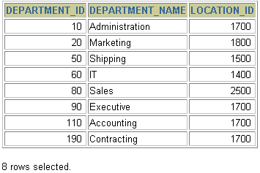

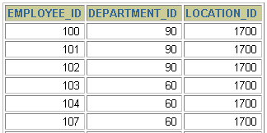
Generating a Cartesian Product
EMPLOYEES (20 rows)
DEPARTMENTS (8 rows)
…
Cartesian product: 20x8=160 rows
…
Notes:
Cartesian Products (continued)
A Cartesian product is generated if a join condition is omitted. The example on the slide displays employee last name and department name from the EMPLOYEES and DEPARTMENTS tables. Because no WHERE clause has been specified, all rows (20 rows) from the EMPLOYEES table are joined with all rows (8 rows) in the DEPARTMENTS table, thereby generating 160 rows in the output.
SELECT last_name, department_name dept_name
FROM employees, departments;
Instructor Note
Demo: 4_cart.sql
Purpose: To illustrate executing a Cartesian product
…

Slide 97
Joining Tables
Use a join to query data from more than one table.
Write the join condition in the WHERE clause.
Prefix the column name with the table name when the same column name appears in more than one table.
SELECT table1.column, table2.column
FROM table1, table2
WHERE table1.column1 = table2.column2;
Notes:
Defining Joins
When data from more than one table in the database is required, a join condition is used. Rows in one table can be joined to rows in another table according to common values existing in corresponding columns, that is, usually primary and foreign key columns.
To display data from two or more related tables, write a simple join condition in the WHERE clause.
In the syntax:
table1.column denotes the table and column from which data is retrieved
table1.column1 = is the condition that joins (or relates) the tables together table2.column2
Guidelines
When writing a SELECT statement that joins tables, precede the column name with the table name for clarity and to enhance database access.
If the same column name appears in more than one table, the column name must be prefixed with the table name.
To join n tables together, you need a minimum of n-1 join conditions. For example, to join four tables, a minimum of three joins is required. This rule may not apply if your table has a concatenated primary key, in which case more than one column is required to uniquely identify each row.
For more information, see Oracle9i SQL Reference, “SELECT.”

Slide 98
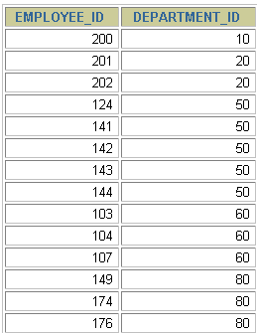
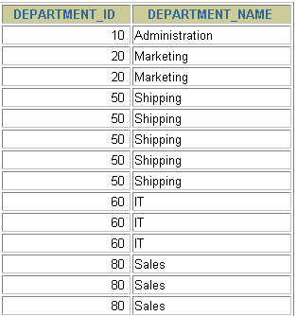
What is an Equijoin?
EMPLOYEES
DEPARTMENTS
…
…
Foreign key
Primary key
Notes:
Equijoins
To determine an employee’s department name, you compare the value in the DEPARTMENT_ID column in the EMPLOYEES table with the DEPARTMENT_ID values in the DEPARTMENTS table. The relationship between the EMPLOYEES and DEPARTMENTS tables is an equijoin—that is, values in the DEPARTMENT_ID column on both tables must be equal. Frequently, this type of join involves primary and foreign key complements.
Note: Equijoins are also called simple joins or inner joins.
Instructor Note
Explain the use of a decision matrix for simplifying writing joins. For example, if you want to display the name and department number of all the employees who are in the same department as Goyal, you can start by making the following decision tree:
Columns to Display Originating Table Condition
last_name employees last_name='Goyal'
department_name departments employees.department_id =
departments.department_id
Now the SQL statement can be easily formulated by looking at the decision matrix. The first column gives the column list in the SELECT statement, the second column gives the tables for the FROM clause, and the third column gives the condition for the WHERE clause.

Slide 99
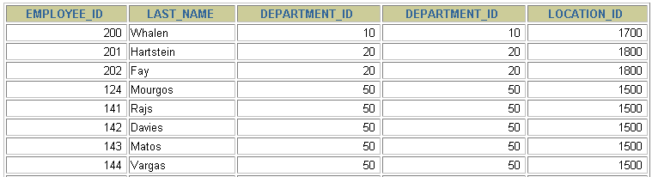
Retrieving Records with Equijoins
SELECT employees.employee_id, employees.last_name,
employees.department_id, departments.department_id,
departments.location_id
FROM employees, departments
WHERE employees.department_id = departments.department_id;
…
Notes:
Retrieving Records with Equijoins
In the slide example:
The SELECT clause specifies the column names to retrieve:
employee last name, employee number, and department number, which are columns in the EMPLOYEES table
department number, department name, and location ID, which are columns in the DEPARTMENTS table
The FROM clause specifies the two tables that the database must access:
EMPLOYEES table
DEPARTMENTS table
The WHERE clause specifies how the tables are to be joined:
EMPLOYEES.DEPARTMENT_ID = DEPARTMENTS.DEPARTMENT_ID
Because the DEPARTMENT_ID column is common to both tables, it must be prefixed by the table name to avoid ambiguity.

Slide 100
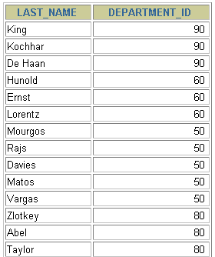
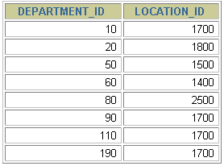
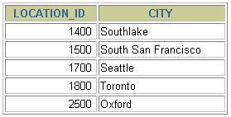
Joining More than Two Tables
EMPLOYEES
DEPARTMENTS
LOCATIONS
…
To join n tables together, you need a minimum of n-1 join conditions. For example, to join three tables, a minimum of two joins is required.
Notes:
Additional Search Conditions
Sometimes you may need to join more than two tables. For example, to display the last name, the department name, and the city for each employee, you have to join the EMPLOYEES, DEPARTMENTS, and LOCATIONS tables.
SELECT e.last_name, d.department_name, l.city
FROM employees e, departments d, locations l
WHERE e.department_id = d.department_id
AND d.location_id = l.location_id;
…

Slide 101
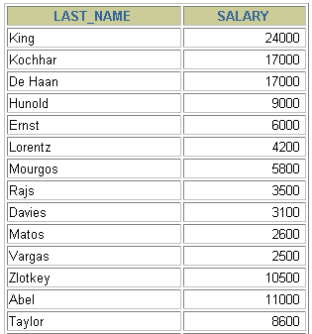
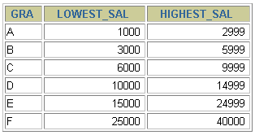
Non-Equijoins
EMPLOYEES
JOB_GRADES
Salary in the EMPLOYEES
table must be between
lowest salary and highest
salary in the JOB_GRADES
table.
…
Notes:
Non-Equijoins
A non-equijoin is a join condition containing something other than an equality operator.
The relationship between the EMPLOYEES table and the JOB_GRADES table has an example of a non-equijoin. A relationship between the two tables is that the SALARY column in the EMPLOYEES table must be between the values in the LOWEST_SALARY and HIGHEST_SALARY columns of the JOB_GRADES table. The relationship is obtained using an operator other than equals (=).

Slide 102
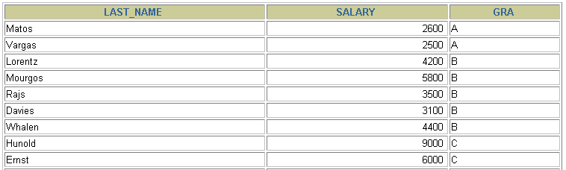
Retrieving Records with Non-Equijoins
SELECT e.last_name, e.salary, j.grade_level
FROM employees e, job_grades j
WHERE e.salary
BETWEEN j.lowest_sal AND j.highest_sal;
…
Notes:
Non-Equijoins (continued)
The slide example creates a non-equijoin to evaluate an employee’s salary grade. The salary must be between any pair of the low and high salary ranges.
It is important to note that all employees appear exactly once when this query is executed. No employee is repeated in the list. There are two reasons for this:
None of the rows in the job grade table contain grades that overlap. That is, the salary value for an employee can lie only between the low salary and high salary values of one of the rows in the salary grade table.
All of the employees’ salaries lie within the limits provided by the job grade table. That is, no employee earns less than the lowest value contained in the LOWEST_SAL column or more than the highest value contained in the HIGHEST_SAL column.
Note: Other conditions, such as <= and >= can be used, but BETWEEN is the simplest. Remember to specify the low value first and the high value last when using BETWEEN.
Table aliases have been specified in the slide example for performance reasons, not because of possible ambiguity.
Instructor Note
Explain that BETWEEN … AND … is actually translated by the Oracle server to a pair of AND conditions (a >= lower limit) and (a <= higher limit) and IN ( … ) is translated by the Oracle server to a set of OR conditions (a = value1 OR a = value2 OR a = value3 ). So using BETWEEN … AND … , IN(…) has no performance benefits; the benefit is logical simplicity.

Slide 103
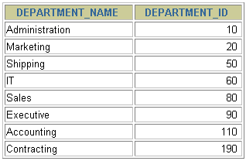
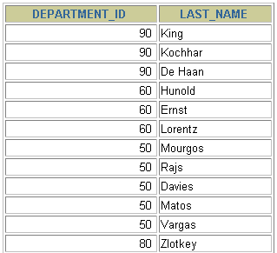
Outer Joins
DEPARTMENTS
EMPLOYEES
…
There are no employees in department 190.
Notes:
Returning Records with No Direct Match with Outer Joins
If a row does not satisfy a join condition, the row will not appear in the query result. For example, in the equijoin condition of EMPLOYEES and DEPARTMENTS tables, employee Grant does not appear because there is no department ID recorded for her in the EMPLOYEES table. Instead of seeing 20 employees in the result set, you see 19 records.
SELECT e.last_name, e.department_id, d.department_name
FROM employees e, departments d
WHERE e.department_id = d.department_id;
…

Slide 104
Outer Joins Syntax
You use an outer join to also see rows that do not meet the join condition.
The Outer join operator is the plus sign (+).
SELECT table1.column, table2.column
FROM table1, table2
WHERE table1.column += table2.column;
SELECT table1.column, table2.column
FROM table1, table2
WHERE table1.column +=+ table2.column;
Notes:
Using Outer Joins to Return Records with No Direct Match
The missing rows can be returned if an outer join operator is used in the join condition. The operator is a plus sign enclosed in parentheses (+), and it is placed on the “side” of the join that is deficient in information. This operator has the effect of creating one or more null rows, to which one or more rows from the nondeficient table can be joined.
In the syntax:
table1.column = is the condition that joins (or relates) the tables together.
table2.column (+) is the outer join symbol, which can be placed on either side of the WHERE clause condition, but not on both sides. (Place the outer join symbol following the name of the column in the table without the matching rows.)
Instructor Note
Demo: 4_ejoin.sql
Purpose: To illustrate an equijoin leading to an outer join.

Slide 105
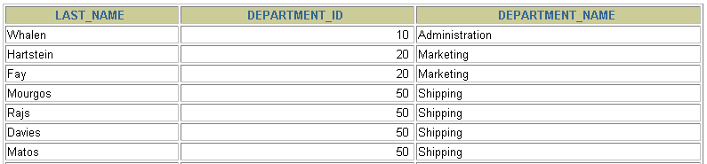
RIGHT Outer Joins
SELECT e.last_name, e.department_id, d.department_name
FROM employees e, departments d
WHERE e.department_id =+ d.department_id ;
…
Notes:
Using Outer Joins to Return Records with No Direct Match (continued)
The slide example displays employee last names, department ID’s and department names. The Contracting department does not have any employees. The empty value is shown in the output shown.
Outer Join Restrictions
The outer join operator can appear on only one side of the expression—the side that has information missing. It returns those rows from one table that have no direct match in the other table.
A condition involving an outer join cannot use the IN operator or be linked to another condition by the OR operator.
Instructor Note
The UNION operator works around the issue of being able to use an outer join operator on one side of the expression. The ANSI full outer join also allows you to have an outer join on both sides of the expression. It is discussed later in this lesson.
Demo: 4_ojoin.sql
Purpose: To illustrate an outer join.

Slide 106

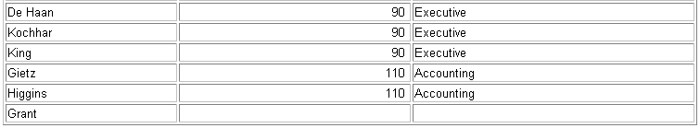
LEFT Outer Joins
SELECT e.last_name, e.department_id, d.department_name
FROM employees e, departments d
WHERE e.department_id += d.department_id ;
…
Notes:
Using Outer Joins to Return Records with No Direct Match (continued)
The slide example displays employee last names, department ID’s and department names. The Contracting department does not have any employees. The empty value is shown in the output shown.
Outer Join Restrictions
The outer join operator can appear on only one side of the expression—the side that has information missing. It returns those rows from one table that have no direct match in the other table.
A condition involving an outer join cannot use the IN operator or be linked to another condition by the OR operator.
Instructor Note
The UNION operator works around the issue of being able to use an outer join operator on one side of the expression. The ANSI full outer join also allows you to have an outer join on both sides of the expression. It is discussed later in this lesson.
Demo: 4_ojoin.sql
Purpose: To illustrate an outer join.

Slide 107
LEFT OUTER JOIN
SELECT e.last_name, e.department_id, d.department_name
FROM employees e
LEFT OUTER JOIN departments d
ON (e.department_id = d.department_id) ;
…
Notes:
Example of LEFT OUTER JOIN
This query retrieves all rows in the EMPLOYEES table, which is the left table even if there is no match in the DEPARTMENTS table.
This query was completed in earlier releases as follows:
SELECT e.last_name, e.department_id, d.department_name
FROM employees e, departments d
WHERE d.department_id (+) = e.department_id;

Slide 108
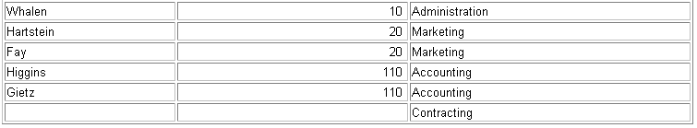
RIGHT OUTER JOIN
SELECT e.last_name, e.department_id, d.department_name
FROM employees e
RIGHT OUTER JOIN departments d
ON (e.department_id = d.department_id) ;
…
Notes:
Example of RIGHT OUTER JOIN
This query retrieves all rows in the DEPARTMENTS table, which is the right table even if there is no match in the EMPLOYEES table.
This query was completed in earlier releases as follows:
SELECT e.last_name, e.department_id, d.department_name
FROM employees e, departments d
WHERE d.department_id = e.department_id (+);

Slide 109
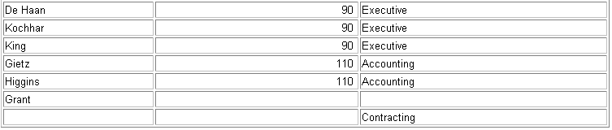
FULL OUTER JOIN
SELECT e.last_name, e.department_id, d.department_name
FROM employees e
FULL OUTER JOIN departments d
ON (e.department_id = d.department_id) ;
…
Notes:
Example of FULL OUTER JOIN
This query retrieves all rows in the EMPLOYEES table, even if there is no match in the DEPARTMENTS table. It also retrieves all rows in the DEPARTMENTS table, even if there is no match in the EMPLOYEES table.
Instructor Note
It was not possible to complete this in earlier releases using outer joins. However, you could accomplish the same results using the UNION operator.
SELECT e.last_name, e.department_id, d.department_name
FROM employees e, departments d
WHERE e.department_id (+) = d.department_id
UNION
SELECT e.last_name, e.department_id, d.department_name
FROM employees e, departments d
WHERE e.department_id = d.department_id (+);

Slide 110
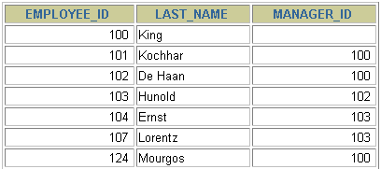
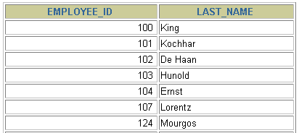
Self Joins
EMPLOYEES (WORKER)
EMPLOYEES (MANAGER)
…
…
MANAGER_ID in the WORKER table is equal to EMPLOYEE_ID in the MANAGER table.
Notes:
Joining a Table to Itself
Sometimes you need to join a table to itself. To find the name of each employee’s manager, you need to join the EMPLOYEES table to itself, or perform a self join. For example, to find the name of Whalen’s manager, you need to:
Find Whalen in the EMPLOYEES table by looking at the LAST_NAME column.
Find the manager number for Whalen by looking at the MANAGER_ID column. Whalen’s manager number is 101.
Find the name of the manager with EMPLOYEE_ID 101 by looking at the LAST_NAME column. Kochhar’s employee number is 101, so Kochhar is Whalen’s manager.
In this process, you look in the table twice. The first time you look in the table to find Whalen in the LAST_NAME column and MANAGER_ID value of 101. The second time you look in the EMPLOYEE_ID column to find 101 and the LAST_NAME column to find Kochhar.
Instructor Note
Show the data from the EMPLOYEES table and point out how each manager is also an employee.

Slide 111
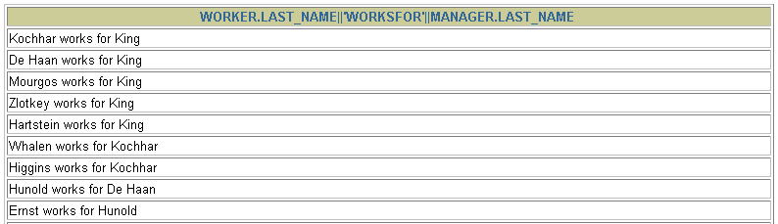
Joining a Table to Itself
SELECT worker.last_name || ' works for '
|| manager.last_name
FROM employees worker, employees manager
WHERE worker.manager_id = manager.employee_id ;
…
Notes:
Joining a Table to Itself (continued)
The slide example joins the EMPLOYEES table to itself. To simulate two tables in the FROM clause, there are two aliases, namely w and m, for the same table, EMPLOYEES.
In this example, the WHERE clause contains the join that means “where a worker’s manager number matches the employee number for the manager.”
Instructor Note
Point out the following to the students:
The column heading in the result of the query on the slide seems meaningless. A meaningful column alias should have been used instead.
There are only 19 rows in the output, but there are 20 rows in the EMPLOYEES table. This occurs because employee King, who is the president, does not have a manager.

Slide 112

Creating Cross Joins
The CROSS JOIN clause produces the cross-product of two tables.
This is the same as a Cartesian product between the two tables.
SELECT last_name, department_name
FROM employees
CROSS JOIN departments ;
…
Notes:
Creating Cross Joins
The example on the slide gives the same results as the following:
SELECT last_name, department_name
FROM employees, departments;
…

Slide 113

Additional Conditions
SELECT e.employee_id, e.last_name, e.department_id,
d.department_id, d.location_id
FROM employees e JOIN departments d
ON (e.department_id = d.department_id)
AND e.manager_id = 149 ;
Notes:
Applying Additional Conditions
You can apply additional conditions in the WHERE clause. The example shown performs a join on the EMPLOYEES and DEPARTMENTS tables, and, in addition, displays only employees with a manager ID equal to 149.

Slide 114
Formal Relational Query Languages
Two mathematical Query Languages form the basis for “real” languages (e.g. SQL), and for implementation:
Relational Algebra:
More operational(procedural), very useful for representing execution plans.
Relational Calculus: Lets users describe what they want, rather than how to compute it. (Non-operational, declarative.)

Slide 115
Relational Algebra
The basic set of operations for the relational model is known as the relational algebra. These operations enable a user to specify basic retrieval requests.
Procedural language.
The result of a retrieval is a new relation, which may have been formed from one or more relations. The algebra operations thus produce new relations, which can be further manipulated using operations of the same algebra.
A sequence of relational algebra operations forms a relational algebra expression, whose result will also be a relation that represents the result of a database query (or retrieval request).

Slide 116
Relational Algebra
Basic operations:
Selection ( ) Selects a subset of rows from relation.
Projection ( ) Deletes unwanted columns from relation.
Cross-product ( ) Allows us to combine two relations.
Set-difference ( ) Tuples in reln. 1, but not in reln. 2.
Union ( ) Tuples in reln. 1 and in reln. 2.
Additional operations:
Intersection, join, division, renaming
Since each operation returns a relation, operations can be composed
Notes:
6

Slide 117
Unary Relational Operations
SELECT Operation
SELECT operation is used to select a subset of the tuples from a
relation that satisfy a selection condition. It is a filter that keeps only
those tuples that satisfy a qualifying condition – those satisfying the
condition are selected while others are discarded.
Example: To select the EMPLOYEE tuples whose department number is four or those whose salary is greater than $30,000 the following notation is used:
σDNO = 4 (EMPLOYEE)
σSALARY > 30,000 (EMPLOYEE)
In general, the select operation is denoted by _{σ <selection condition>}(R) where the
symbol σ (sigma) is used to denote the select operator, and the selection condition is a Boolean expression specified on the attributes of relation R

Slide 118
Selection(σ)
Selects rows that satisfy selection condition.
In general, the SELECT operation is denoted by
σ<selection condition>(R)
Notes:
8

Slide 119
Unary Relational Operations
SELECT Operation Properties
The SELECT operation σ _{<selection condition>}(R) produces a relation S that has the same schema as R
A cascaded SELECT operation may be replaced by a single selection with a conjunction of all the conditions; i.e.
= σ <condition1> AND < condition2> AND < condition3> ( R)

Slide 120
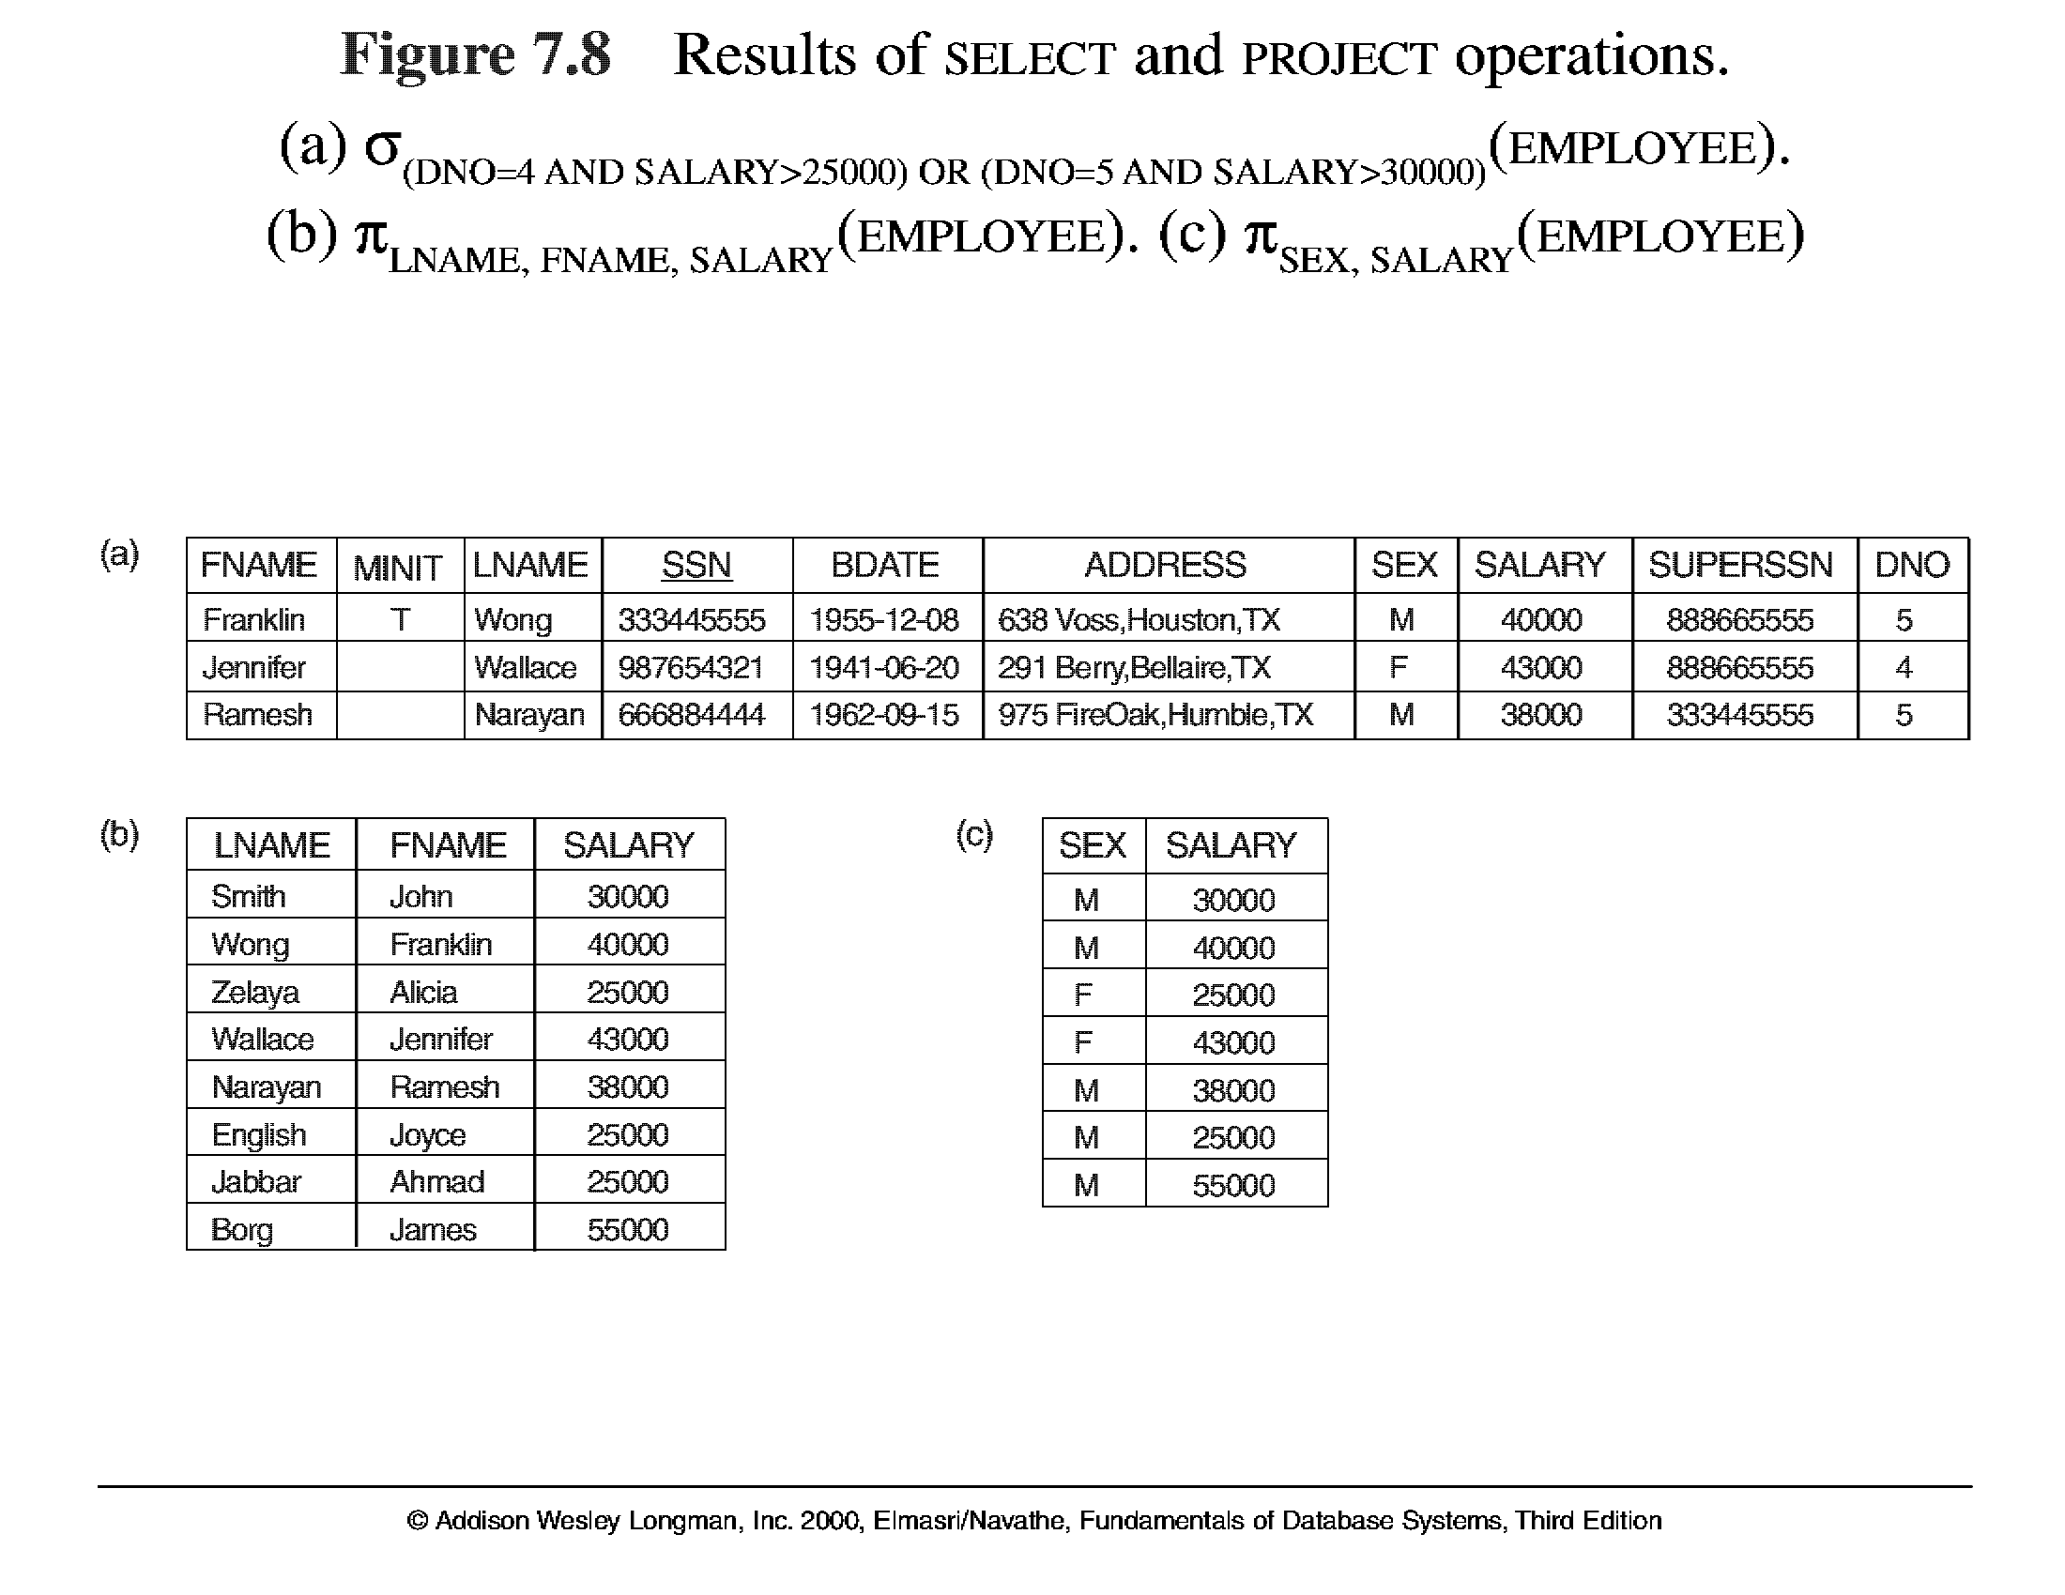
Unary Relational Operations (cont.)

Slide 121
Unary Relational Operations (cont.)
PROJECT Operation(π)
This operation selects certain columns from the table and discards the other columns. The PROJECT creates a vertical partitioning – one with the needed columns (attributes) containing results of the operation and other containing the discarded Columns.
Example: To list each employee’s first and last name and salary, the following is used:
π_{LNAME, FNAME,SALARY}(EMPLOYEE)
The general form of the project operation is π<attribute list>(R) where π (pi) is the symbol used to represent the project operation and <attribute list> is the desired list of attributes from the attributes of relation R.
The project operation removes any duplicate tuples, so the result of the project operation is a set of tuples and hence a valid relation.

Slide 122
Unary Relational Operations (cont.)

Slide 123
RENAME(ρ)
ρS(B1, B2, ..., Bn)(R) or ρS(R) or ρ(B1, B2, ..., Bn)(R)
where the symbol ρ (rho) is used to denote the RENAME operator, S is the new relation
name, and B1, B2, ..., Bn are the new attribute names.
The first expression renames both the relation and its attributes, the second renames the relation only,
and the third renames the attributes only. If the attributes of R are (A1, A2, ..., An) in
that order, then each Ai is renamed as Bi

Slide 124
Relational Algebra Operations From Set Theory
UNION Operation
The result of this operation, denoted by R ∪ S, is a relation that includes all tuples that are either in R or in S or in both R and S. Duplicate tuples are eliminated.
Example: To retrieve the social security numbers of all employees who either work in department 5 or directly supervise an employee who works in department 5, we can use the union operation as follows:
DEP5_EMPS ← σ_{DNO=5} (EMPLOYEE)
RESULT1 ← π _{SSN}(DEP5_EMPS)
RESULT2 ← π _{SUPERSSN}(DEP5_EMPS)
RESULT ← RESULT1 ∪ RESULT2
The union operation produces the tuples that are in either RESULT1 or RESULT2 or both. The two operands must be “type compatible”.

Slide 125
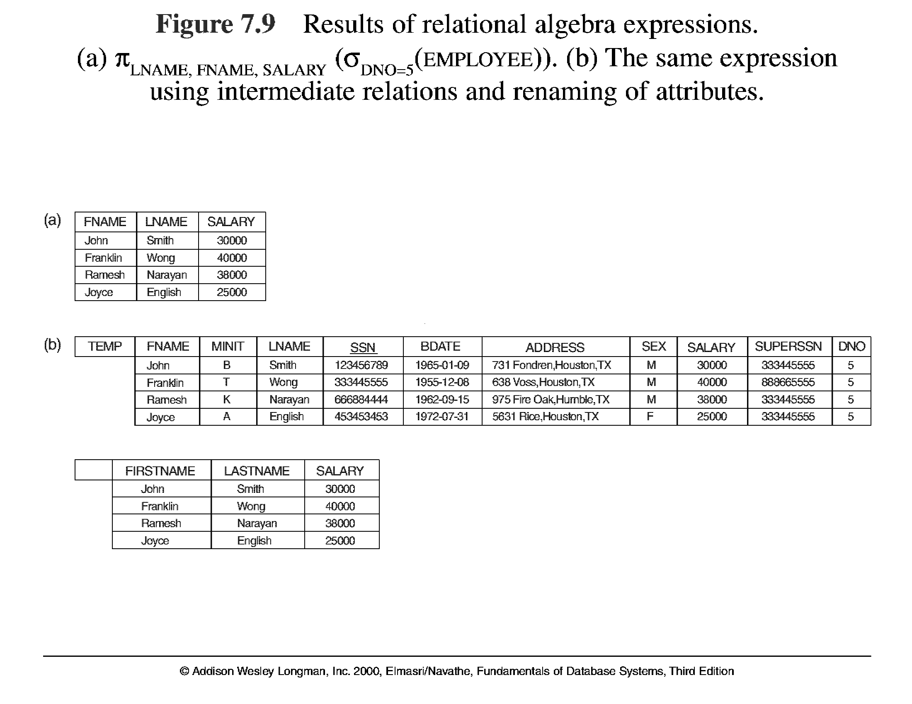
Unary Relational Operations (cont.)

Slide 126
Relational Algebra Operations From Set Theory
Type Compatibility
The operand relations R₁(A₁, A₂, ..., A_{n}) and R₂(B₁, B₂, ..., B_{n}) must have the same number of attributes, and the domains of corresponding attributes must be compatible; that is, dom(A_{i})=dom(B_{i}) for i=1, 2, ..., n.
The resulting relation for R₁∪R₂,R₁ ∩ R₂, or R₁-R₂ has the same attribute names as the first operand relation R1 (by convention).

Slide 127
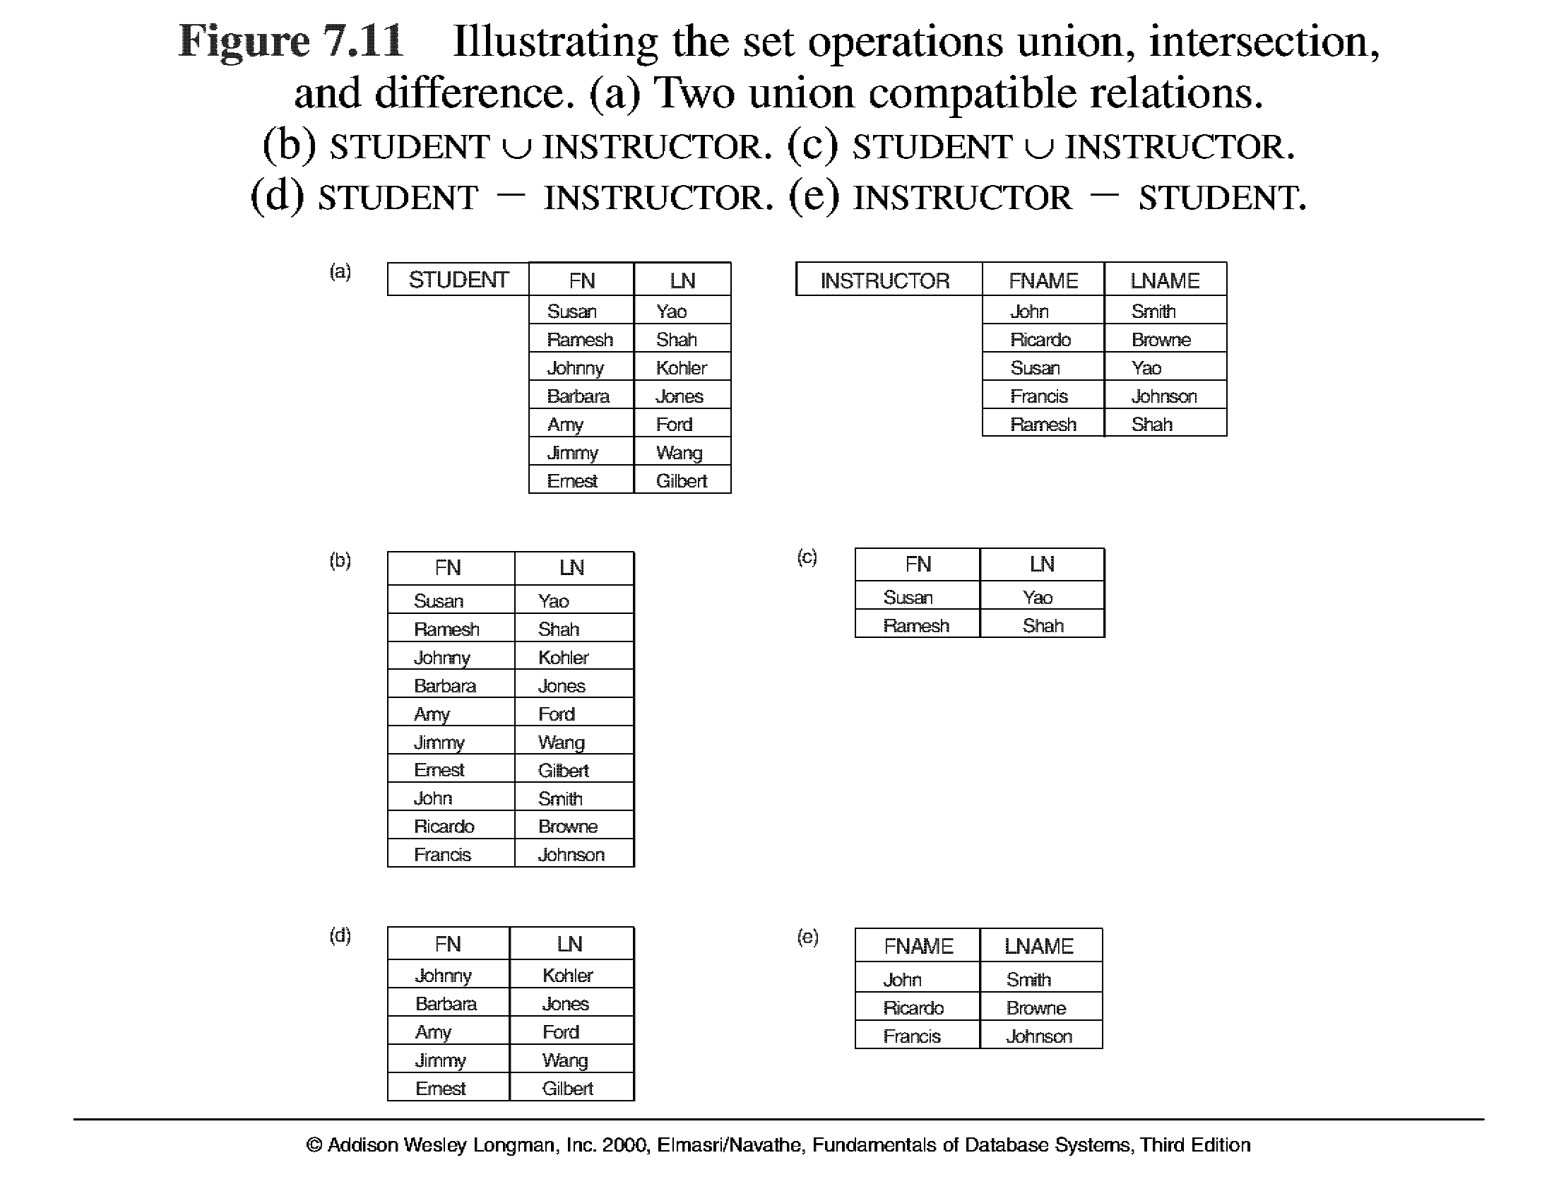
Relational Algebra Operations From Set Theory (cont.) – use Fig. 6.4

Slide 128
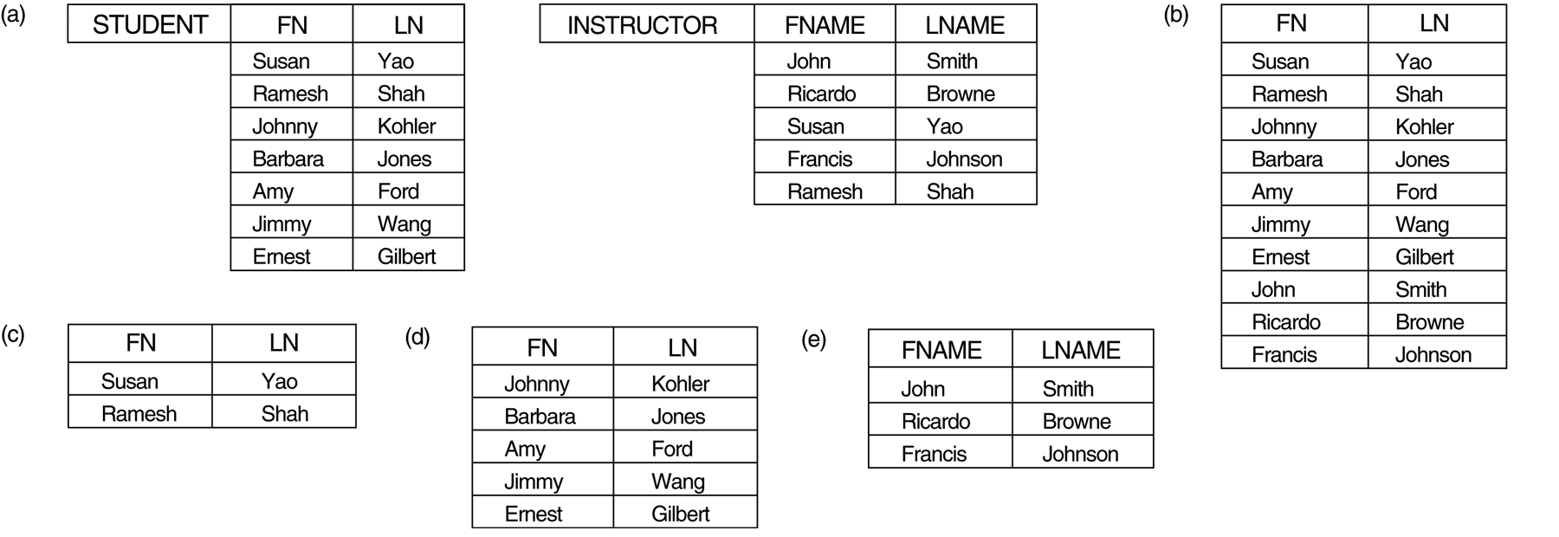
Relational Algebra Operations From Set Theory (cont.)
INTERSECTION OPERATION
The result of this operation, denoted by R ∩ S, is a relation that includes all tuples that are in both R and S. The two operands must be "type compatible"
Example: The result of the intersection operation (figure below) includes only those who are both students and instructors.
STUDENT ∩ INSTRUCTOR

Slide 129
Relational Algebra Operations From Set Theory (cont.)
Set Difference (or MINUS) Operation
The result of this operation, denoted by R - S, is a relation that includes all tuples that are in R but not in S. The two operands must be "type compatible”.
Example: The figure shows the names of students who are not instructors, and the names of instructors who are not students.
STUDENT-INSTRUCTOR
INSTRUCTOR-STUDENT

Slide 130
Relational Algebra Operations From Set Theory (cont.)
Notice that both union and intersection are commutative operations; that is
R ∪ S = S ∪ R, and R ∩ S = S ∩ R
Both union and intersection can be treated as n-ary operations applicable to any number of relations as both are associative operations; that is
R ∪ (S ∪ T) = (R ∪ S) ∪ T, and (R ∩ S) ∩ T = R ∩ (S ∩ T)
The minus operation is not commutative; that is, in general
R - S ≠ S – R

Slide 131
Relational Algebra Operations From Set Theory (cont.)
CARTESIAN (or cross product) Operation
This operation is used to combine tuples from two relations in a combinatorial fashion. In general, the result of R(A₁, A₂, . . ., A_{n}) x S(B₁, B₂, . ., B_{m}) is a relation Q with degree n + m attributes Q(A₁, A₂, . . ., A_{n}, B₁, B₂, . . ., B_{m}), in that order. The resulting relation Q has one tuple for each combination of tuples—one from R and one from S.
Hence, if R has n_{R} tuples (denoted as |R| = n_{R} ), and S has n_{S} tuples, the| R x S | will have n_{R} * n_{S} tuples.
The two operands do NOT have to be "type compatible”
Example:
FEMALE_EMPS ← σ _{SEX=’F’}(EMPLOYEE)
EMPNAMES ← π _{FNAME, LNAME, SSN} (FEMALE_EMPS)
EMP_DEPENDENTS ← EMPNAMES x DEPENDENT

Slide 132
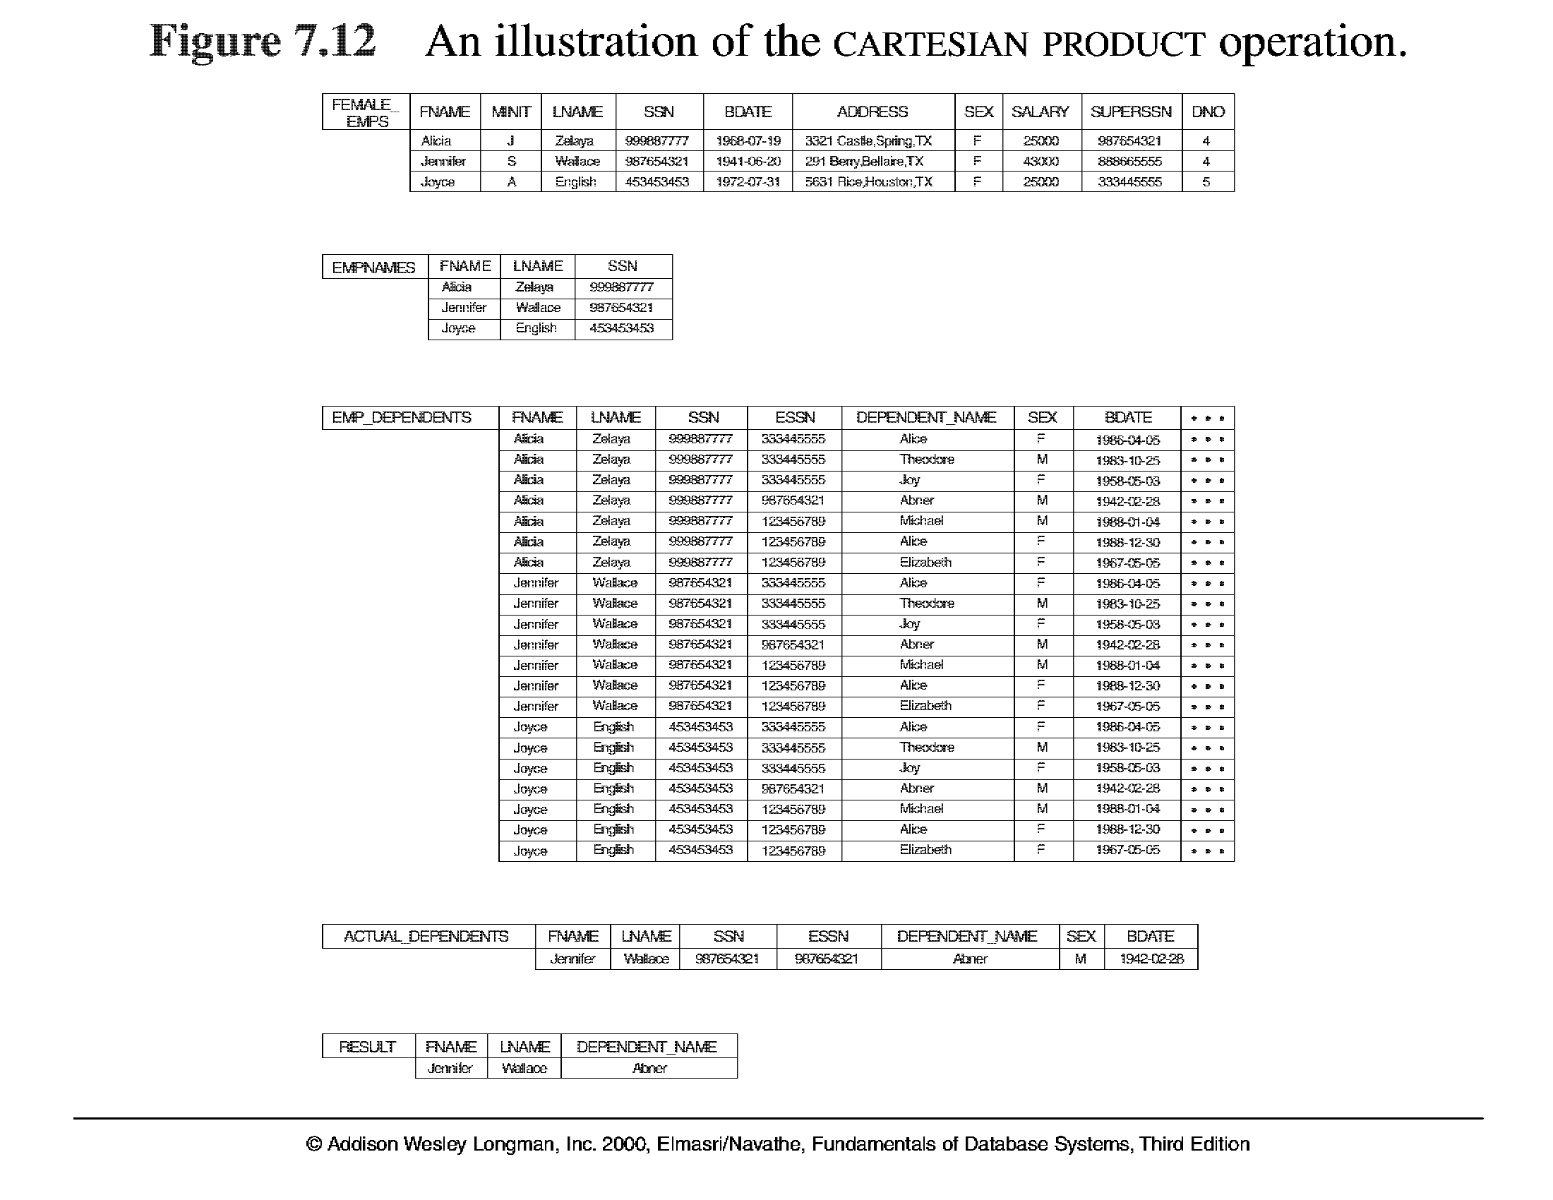
Relational Algebra Operations From Set Theory (cont.)

Slide 133
Binary Relational Operations
JOIN Operation
The sequence of cartesian product followed by select is used quite commonly to identify and select related tuples from two relations, a special operation, called JOIN. It is denoted by a
This operation is very important for any relational database with more than a single relation, because it allows us to process relationships among relations.
The general form of a join operation on two relations R(A₁, A₂, . . ., A_{n}) and S(B₁, B₂, . . ., B_{m}) is:
R _{<join condition>}S
where R and S can be any relations that result from general relational algebra expressions.

Slide 134
Joins
Condition Join or theta:
θ (theta) is one of the comparison operators {=, <, ≤, >, ≥, ≠}.
Result schema same as that of cross-product.
Fewer tuples than cross-product. Filters tuples not satisfying the join condition.
Sometimes called a theta-join.
Notes:
11

Slide 135
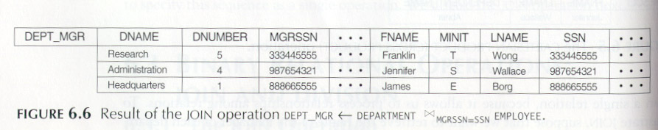
Binary Relational Operations (cont.)
Example: Suppose that we want to retrieve the name of the manager of each department. To get the manager’s name, we need to combine each DEPARTMENT tuple with the EMPLOYEE tuple whose SSN value matches the MGRSSN value in the department tuple. We do this by using the join operation.
DEPT_MGR ← DEPARTMENT _{MGRSSN=SSN} EMPLOYEE
RESULT ← πDname, Lname, Fname(DEPT_MGR)

Slide 136
Binary Relational Operations (cont.)
EQUIJOIN Operation(=)
The most common use of join involves join conditions with equality comparisons only. Such a join, where the only comparison operator used is =, is called an EQUIJOIN. In the result of an EQUIJOIN we always have one or more pairs of attributes (whose names need not be identical) that have identical values in every tuple.
The JOIN seen in the previous example was EQUIJOIN.

Slide 137
NATURAL JOIN Operation(*)
Because one of each pair of attributes with identical values is superfluous, a new operation called natural join was created to get rid of the second attribute in an EQUIJOIN condition.
The standard definition of natural join requires that the two join attributes, or each pair of corresponding join attributes, have the same name in both relations. If this is not the case, a renaming operation is applied first.
ex:combine each PROJECT tuple with the DEPARTMENT tuple that controls the project.
PROJ_DEPT ← PROJECT * ρ(Dname, Dnum, Mgr_ssn, Mgr_start_date)(DEPARTMENT)
or
DEPT←ρ(Dname,Dnum,Mgr_ssn,Mgr_start_date)(DEPARTMENT)
PROJ_DEPT ← PROJECT * DEPT

Slide 138
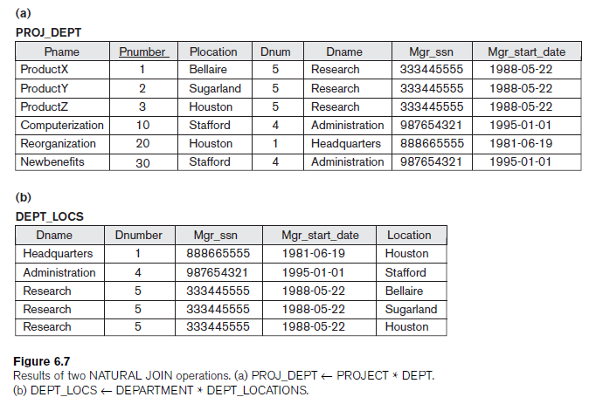
Binary Relational Operations (cont.)

Slide 139
Complete Set of Relational Operations
The set of operations including select σ, project π , union ∪, set difference - , and cartesian product X is called a complete set because any other relational algebra expression can be expressed by a combination of these five operations.
For example:
R ∩ S = (R ∪ S ) – ((R − S) ∪ (S − R))
R _{<join condition>}S = σ _{<join condition>} (R X S)

Slide 140
Binary Relational Operations (cont.)
DIVISION Operation
The division operation is applied to two relations
R(Z) ÷ S(X), where X subset Z. Let Y = Z - X (and hence Z = X ∪ Y); that is, let Y be the set of attributes of R that are not attributes of S.
The result of DIVISION is a relation T(Y) that includes a tuple t if tuples t_{R} appear in R with t_{R} [Y] = t, and with
t_{R} [X] = t_{s} for every tuple t_{s} in S.
For a tuple t to appear in the result T of the DIVISION, the values in t must appear in R in combination with every tuple in S.

Slide 141
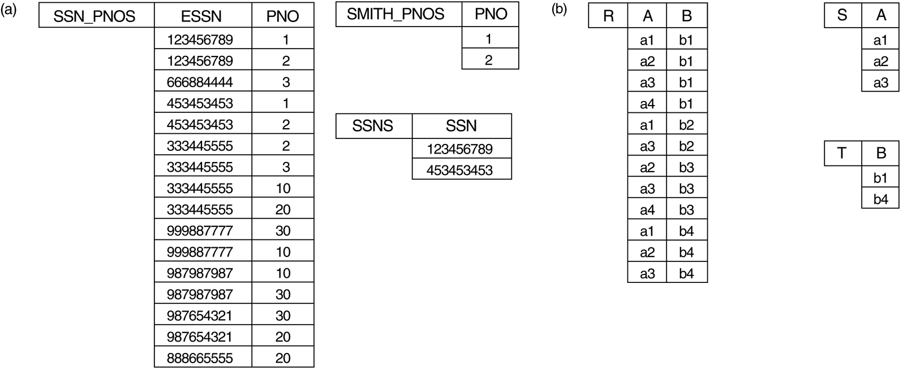
Binary Relational Operations (cont.)

Slide 142
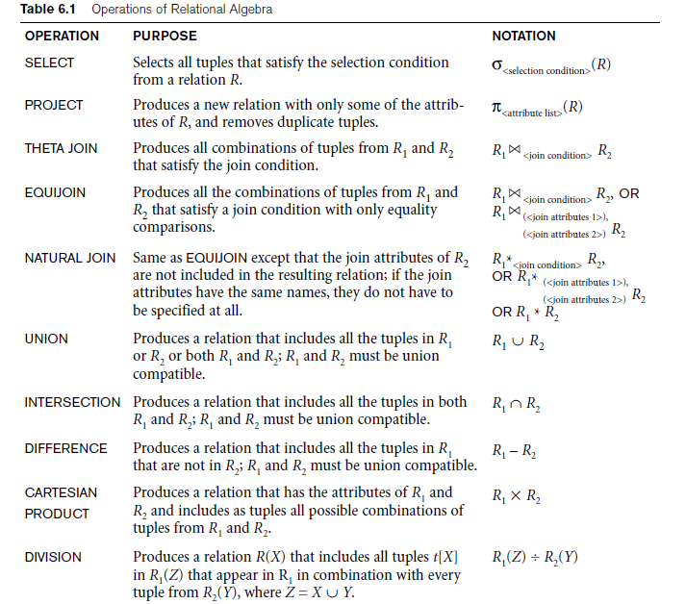
Recap of Relational Algebra Operations

Slide 143
<grouping attributes> ℑ <function list> (R)
AGGREGATE FUNCTION operation, using the symbol ℑ (pronounced script F)
where <grouping attributes> is a list of attributes of the relation specified in R,
<function list> is a list of (<function> <attribute>) pairs.
In each such pair,<function> is one of the allowed functions—such as SUM, AVERAGE, MAXIMUM,
MINIMUM,COUNT—and <attribute> is an attribute of the relation specified by R.

Slide 144
Additional Relational Operations
Aggregate Functions and Grouping
A type of request that cannot be expressed in the basic relational algebra is to specify mathematical aggregate functions on collections of values from the database.
Examples of such functions include retrieving the average or total salary of all employees or the total number of employee tuples. These functions are used in simple statistical queries that summarize information from the database tuples.
Common functions applied to collections of numeric values include SUM, AVERAGE, MAXIMUM, and MINIMUM. The COUNT function is used for counting tuples or values.

Slide 145
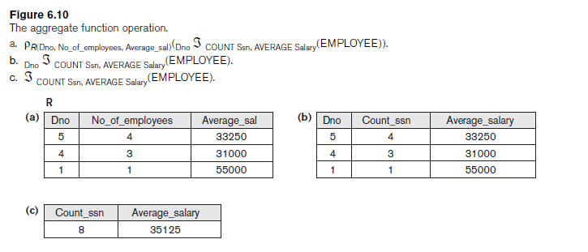

Slide 146
Additional Relational Operations (cont.)
Use of the Functional operator ℱ
ℱ_{MAX Salary} (Employee) retrieves the maximum salary value from the Employee relation
ℱ_{MIN Salary} (Employee) retrieves the minimum Salary value from the Employee relation
ℱ_{SUM Salary} (Employee) retrieves the sum of the Salary from the Employee relation
_{DNO} ℱ_{COUNT SSN, AVERAGE Salary} (Employee) groups employees by DNO (department number) and computes the count of employees and average salary per department.[ Note: count just counts the number of rows, without removing duplicates]

Slide 147
Additional Relational Operations (cont.)
The OUTER JOIN Operation
In NATURAL JOIN tuples without a matching (or related) tuple are eliminated from the join result. Tuples with null in the join attributes are also eliminated. This amounts to loss of information.
A set of operations, called outer joins, can be used when we want to keep all the tuples in R, or all those in S, or all those in both relations in the result of the join, regardless of whether or not they have matching tuples in the other relation.
The left outer join operation keeps every tuple in the first or left relation R in R S; if no matching tuple is found in S, then the attributes of S in the join result are filled or “padded” with null values.
A similar operation, right outer join, keeps every tuple in the second or right relation S in the result of R S.
A third operation, full outer join, denoted by keeps all tuples in both the left and the right relations when no matching tuples are found, padding them with null values as needed.

Slide 148
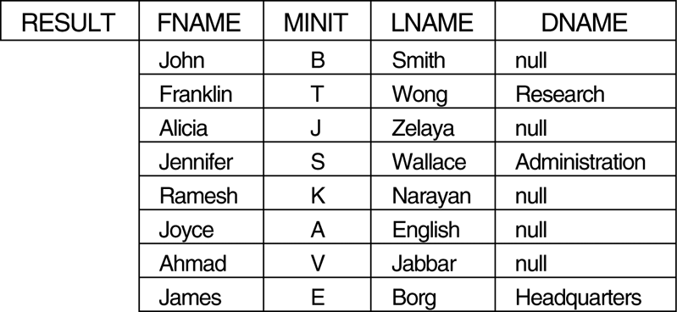
Additional Relational Operations (cont.)

Slide 149
Examples of Queries in Relational Algebra
Q1: Retrieve the name and address of all employees who work for the ‘Research’ department.
RESEARCH_DEPT ← σ DNAME=’Research’ (DEPARTMENT)
RESEARCH_EMPS ← (RESEARCH_DEPT _{DNUMBER= DNO}EMPLOYEE)
RESULT ← π FNAME, LNAME, ADDRESS (RESEARCH_EMPS)

Slide 150
Relational Calculus
A relational calculus expression creates a new relation, which is specified in terms of variables that range over rows of the stored database relations (in tuple calculus) or over columns of the stored relations (in domain calculus).
In a calculus expression, there is no order of operations to specify how to retrieve the query result—a calculus expression specifies only what information the result should contain. This is the main distinguishing feature between relational algebra and relational calculus.
Relational calculus is considered to be a nonprocedural language. This differs from relational algebra, where we must write a sequence of operations to specify a retrieval request; hence relational algebra can be considered as a procedural way of stating a query.

Slide 151
Tuple Relational Calculus
The tuple relational calculus is based on specifying a number of tuple variables. Each tuple variable usually ranges over a particular database relation, meaning that the variable may take as its value any individual tuple from that relation.
A simple tuple relational calculus query is of the form
{t | COND(t)}
where t is a tuple variable and COND (t) is a conditional expression involving t. The result of such a query is the set of all tuples t that satisfy COND (t).
Example: To find the first and last names of all employees whose salary is above $50,000, we can write the following tuple calculus expression:
{t.FNAME, t.LNAME | EMPLOYEE(t) AND t.SALARY>50000}
The condition EMPLOYEE(t) specifies that the range relation of tuple variable t is EMPLOYEE. The first and last name (PROJECTION π_{FNAME, LNAME}) of each EMPLOYEE tuple t that satisfies the condition t.SALARY>50000 (SELECTION
σ _{SALARY >50000}) will be retrieved.

Slide 152
The Existential and Universal Quantifiers
Two special symbols called quantifiers can appear in formulas; these are the universal quantifier (∀) and the existential quantifier (∃).
Informally, a tuple variable t is bound if it is quantified, meaning that it appears in an (∀ t) or (∃ t) clause; otherwise, it is free.
If F is a formula, then so is (∃ t)(F), where t is a tuple variable. The formula (∃ t)(F) is true if the formula F evaluates to true for some (at least one) tuple assigned to free occurrences of t in F; otherwise (∃ t)(F) is false.
If F is a formula, then so is (∀ t)(F), where t is a tuple variable. The formula (∀ t)(F) is true if the formula F evaluates to true for every tuple (in the universe) assigned to free occurrences of t in F; otherwise (∀ t)(F) is false.
It is called the universal or “for all” quantifier because every tuple in “the universe of” tuples must make F true to make the quantified formula true.

Slide 153
Example Query Using Existential Quantifier
Retrieve the name and address of all employees who work for the ‘Research’ department.
Query :
{t.FNAME, t.LNAME, t.ADDRESS | EMPLOYEE(t) and (∃ d) (DEPARTMENT(d) and d.DNAME=‘Research’ and d.DNUMBER=t.DNO) }
The only free tuple variables in a relational calculus expression should be those that appear to the left of the bar ( | ). In above query, t is the only free variable; it is then bound successively to each tuple. If a tuple satisfies the conditions specified in the query, the attributes FNAME, LNAME, and ADDRESS are retrieved for each such tuple.
The conditions EMPLOYEE (t) and DEPARTMENT(d) specify the range relations for t and d. The condition d.DNAME = ‘Research’ is a selection condition and corresponds to a SELECT operation in the relational algebra, whereas the condition d.DNUMBER = t.DNO is a JOIN condition.

Slide 154
Example Query Using Universal Quantifier
Find the names of employees who work on all the projects controlled by department number 5.
Query :
{e.LNAME, e.FNAME | EMPLOYEE(e) and ( (∀ x)(not(PROJECT(x)) or not(x.DNUM=5)
OR ( (∃ w)(WORKS_ON(w) and w.ESSN=e.SSN and x.PNUMBER=w.PNO) ) ) )}
Exclude from the universal quantification all tuples that we are not interested in by making the condition true for all such tuples. The first tuples to exclude (by making them evaluate automatically to true) are those that are not in the relation R of interest.
In query above, using the expression not(PROJECT(x)) inside the universally quantified formula evaluates to true all tuples x that are not in the PROJECT relation. Then we exclude the tuples we are not interested in from R itself. The expression not(x.DNUM=5) evaluates to true all tuples x that are in the project relation but are not controlled by department 5.
Finally, we specify a condition that must hold on all the remaining tuples in R.
( (∃ w)(WORKS_ON(w) and w.ESSN=e.SSN and x.PNUMBER=w.PNO)

Slide 155
Languages Based on Tuple Relational Calculus
The language SQL is based on tuple calculus. It uses the basic
SELECT <list of attributes>
FROM <list of relations>
WHERE <conditions>
block structure to express the queries in tuple calculus where the SELECT clause mentions the attributes being projected, the FROM clause mentions the relations needed in the query, and the WHERE clause mentions the selection as well as the join conditions.
SQL syntax is expanded further to accommodate other operations. (See Chapter 8).
Another language which is based on tuple calculus is QUEL which actually uses the range variables as in tuple calculus.
Its syntax includes:
RANGE OF <variable name> IS <relation name>
Then it uses
RETRIEVE <list of attributes from range variables>
WHERE <conditions>
This language was proposed in the relational DBMS INGRES.

Slide 156
The Domain Relational Calculus
Another variation of relational calculus called the domain relational calculus, or simply, domain calculus is equivalent to tuple calculus and to relational algebra.
The language called QBE (Query-By-Example) that is related to domain calculus was developed almost concurrently to SQL at IBM Research, Yorktown Heights, New York. Domain calculus was thought of as a way to explain what QBE does.
Domain calculus differs from tuple calculus in the type of variables used in formulas: rather than having variables range over tuples, the variables range over single values from domains of attributes. To form a relation of degree n for a query result, we must have n of these domain variables—one for each attribute.
An expression of the domain calculus is of the form
{x1, x2, . . ., xn | COND(x1, x2, . . ., xn, xn+1, xn+2, . . ., xn+m)}
where x1, x2, . . ., xn, xn+1, xn+2, . . ., xn+m are domain variables that range over domains (of attributes) and COND is a condition or formula of the domain relational calculus.

Slide 157
2.1 Functional Dependencies (1)
Functional dependencies (FDs) are used to specify formal measures of the "goodness" of relational designs
FDs and keys are used to define normal forms for relations
FDs are constraints that are derived from the meaning and interrelationships of the data attributes
A set of attributes X functionally determines a set of attributes Y if the value of X determines a unique value for Y

Slide 158
Functional Dependencies (2)
X -> Y holds if whenever two tuples have the same value for X, they must have the same value for Y
For any two tuples t1 and t2 in any relation instance r(R): If t1[X]=t2[X], then t1[Y]=t2[Y]
X -> Y in R specifies a constraint on all relation instances r(R)
Written as X -> Y; can be displayed graphically on a relation schema as in Figures. ( denoted by the arrow: ).
FDs are derived from the real-world constraints on the attributes

Slide 159
Examples of FD constraints (1)
social security number determines employee name
SSN -> ENAME
project number determines project name and location
PNUMBER -> {PNAME, PLOCATION}
employee ssn and project number determines the hours per week that the employee works on the project
{SSN, PNUMBER} -> HOURS

Slide 160
Examples of FD constraints (2)
An FD is a property of the attributes in the schema R
The constraint must hold on every relation instance r(R)
If K is a key of R, then K functionally determines all attributes in R (since we never have two distinct tuples with t1[K]=t2[K])

Slide 161
2.2 Inference Rules for FDs (1)
Given a set of FDs F, we can infer additional FDs that hold whenever the FDs in F hold
(Dept_no → Mgr_ssn)
(Mgr_ssn→Mgr_phone), then these two dependencies together imply that
Dept_no → Mgr_phone.
This is an inferred FD and need not be explicitly stated in addition to the two given FDs
To determine a systematic way to infer dependencies, we must discover a set of inference rules that can be used to infer new dependencies from a given set of dependencies

Slide 162
Armstrong's inference rules:
IR1. (Reflexive) If X ⊇ Y, then X -> Y
IR2. (Augmentation) If X -> Y, then XZ -> YZ
(Notation: XZ stands for X U Z)
IR3. (Transitive) If X -> Y and Y -> Z, then X -> Z
IR1, IR2, IR3 form a sound and complete set of inference rules
Because IR1 generates dependencies that are always true, such dependencies are called trivial.
Formally, a functional dependency X→Y is trivial if X ⊇ Y; otherwise, it is nontrivial

Slide 163
Inference Rules for FDs (2)
Some additional inference rules that are useful:
(Decomposition) If X -> YZ, then X -> Y and X -> Z
(Union) If X -> Y and X -> Z, then X -> YZ
(Psuedotransitivity) If X -> Y and WY -> Z, then WX -> Z
The last three inference rules, as well as any other inference rules, can be deduced from IR1, IR2, and IR3 (completeness property)

Slide 164
Inference Rules for FDs (3)
Closure of a set F of FDs is the set F⁺ of all FDs that can be inferred from F
F = {Ssn → {Ename, Bdate, Address, Dnumber}, Dnumber → {Dname, Dmgr_ssn} }
Some of the additional functional dependencies that we can infer from F are the following:
Ssn → {Dname, Dmgr_ssn}
Ssn → Ssn
Dnumber → Dname

Slide 165
Closure of a set of attributes X with respect to F is the set X ⁺ of all attributes that are functionally determined by X
X ⁺ can be calculated by repeatedly applying IR1, IR2, IR3 using the FDs in F
F = {Ssn → Ename,
Pnumber → {Pname, Plocation},
{Ssn, Pnumber} → Hours}
Closure:-
{Ssn} + = {Ssn, Ename}
{Pnumber} + = {Pnumber, Pname, Plocation}
{Ssn, Pnumber} + = {Ssn, Pnumber, Ename, Pname, Plocation, Hours}

Slide 166
Properties of Relational Decompositions
Using the functional dependencies, the algorithms decompose the universal relation schema R into a set of relation schemas
D= {R1, R2, ..., Rm} that will become the relational database schema; D is called a
decomposition of R.
Decompostion should be
dependency preserving
Lossless decomposition

Slide 167
Nonadditive (Lossless) Join Property of a Decomposition
Definition. Formally, a decomposition D = {R1, R2, ..., Rm} of R has the lossless(nonadditive) join property with respect to the set of dependencies F on R if,for every relation state r of R that satisfies F, the following holds, where * is the NATURAL JOIN of all the relations in D: *(πR1(r), ..., πRm(r)) = r.

Slide 168
Algorithm
Algorithm 16.3. Testing for Nonadditive Join Property
Input: A universal relation R, a decomposition D = {R1, R2, ..., Rm} of R, and a set F of functional dependencies.
Create an initial matrix S with one row i for each relation Ri in D, and one column j for each attribute Aj in R
2. Set S(i, j):= bij for all matrix entries.
3. For each row i representing relation schema Ri{for each column j representing attribute Aj {if (relation Ri includes attribute Aj) then set S(i, j):= aj;};};

Slide 169
4. Repeat the following loop until a complete loop execution results in no changes to S {for each functional dependency X→Y in F {for all rows in S that have the same symbols in the columns corresponding to attributes in X {make the symbols in each column that correspond to an attribute in be the same in all these rows as follows: If any of the rows has an a symbol for the column, set the other rows to that same a symbol in the column.If no a symbol exists for the attribute in any of the rows, choose one of the b symbols that appears in one of the rows for the attribute and set the other rows to that same b symbol in the column ;} ; } ;};
5. If a row is made up entirely of a symbols, then the decomposition has the nonadditive join property; otherwise, it does not.

Slide 170
Dependency Preservation Property of a Decomposition
Definition. Given a set of dependencies F on R, the projection of F on Ri,denoted by πRi(F) where Ri is a subset of R, is the set of dependencies X→Y in F+ such that the attributes in X ∪ Y are all contained in Ri. Hence, the projection of F on each relation schema Ri in the decomposition D is the set of functional dependencies in F+, the closure of F, such that all their left- and right-hand-side attributes are in Ri. We say that a decomposition D = {R1,R2, ..., Rm} of R is dependency-preserving with respect to F if the union of the projections of F on each Ri in D is equivalent to F; that is, ((πR1(F)) ∪ ... ∪(πRm(F)))+ = F+.

Slide 171
algorithm
It guarantees only the dependency-preserving property; it does not guarantee the nonadditive join property
The first step of Algorithm to find a minimal cover G for F;

Slide 172
2.3 Equivalence of Sets of FDs
Two sets of FDs F and G are equivalent if:
- every FD in F can be inferred from G, and
- every FD in G can be inferred from F
Hence, F and G are equivalent if F ⁺ =G ⁺
Definition: F covers G if every FD in G can be inferred from F (i.e., if G ⁺ subset-of F ⁺)
F and G are equivalent if F covers G and G covers F
There is an algorithm for checking equivalence of sets of FDs

Slide 173
2.4 Minimal Sets of FDs (1)
A set of FDs is minimal if it satisfies the following conditions:
Every dependency in F has a single attribute for its RHS.
We cannot remove any dependency from F and have a set of dependencies that is equivalent to F.
We cannot replace any dependency X -> A in F with a dependency Y -> A, where Y proper-subset-of X ( Y subset-of X) and still have a set of dependencies that is equivalent to F.

Slide 174
Dependency-Preserving Decomposition into 3NF Schemas
Algorithm 16.4. Relational Synthesis into 3NF with Dependency Preservation
Input: A universal relation R and a set of functional dependencies F on the attributes of R.
1. Find a minimal cover G for F (use Algorithm 16.2);
2. For each left-hand-side X of a functional dependency that appears in G, create a relation schema in D with attributes {X ∪ {A1} ∪ {A2} ... ∪ {Ak} },where X→A1, X→A2, ..., X→Ak are the only dependencies in G with X as the left-hand-side (X is the key of this relation);
3. Place any remaining attributes (that have not been placed in any relation) in a single relation schema to ensure the attribute preservation property.

Slide 175
3 Normal Forms Based on Primary Keys
3.1 Normalization of Relations
3.2 Practical Use of Normal Forms
3.3 Definitions of Keys and Attributes Participating in Keys
3.4 First Normal Form
3.5 Second Normal Form
3.6 Third Normal Form

Slide 176
3.1 Normalization of Relations (1)
Normalization: The process of decomposing unsatisfactory "bad" relations by breaking up their attributes into smaller relations
Normal form: Condition using keys and FDs of a relation to certify whether a relation schema is in a particular normal form

Slide 177
3.2 Practical Use of Normal Forms
Normalization is carried out in practice so that the resulting designs are of high quality and meet the desirable properties
The practical utility of these normal forms becomes questionable when the constraints on which they are based are hard to understand or to detect
The database designers need not normalize to the highest possible normal form. (usually up to 3NF, BCNF or 4NF)
Denormalization: the process of storing the join of higher normal form relations as a base relation—which is in a lower normal form

Slide 178
3.3 Definitions of Keys and Attributes Participating in Keys (1)
A superkey of a relation schema R = {A₁, A₂, ...., A_{n}} is a set of attributes S subset-of R with the property that no two tuples t₁ and t₂ in any legal relation state r of R will have t₁[S] = t₂[S]
A key K is a superkey with the additional property that removal of any attribute from K will cause K not to be a superkey any more.

Slide 179
Definitions of Keys and Attributes Participating in Keys (2)
If a relation schema has more than one key, each is called a candidate key. One of the candidate keys is arbitrarily designated to be the primary key, and the others are called secondary keys.
A Prime attribute must be a member of some candidate key
A Nonprime attribute is not a prime attribute—that is, it is not a member of any candidate key.

Slide 180
3.2 First Normal Form
Disallows composite attributes, multivalued attributes, and nested relations; attributes whose values for an individual tuple are non-atomic
Considered to be part of the definition of relation

Slide 181
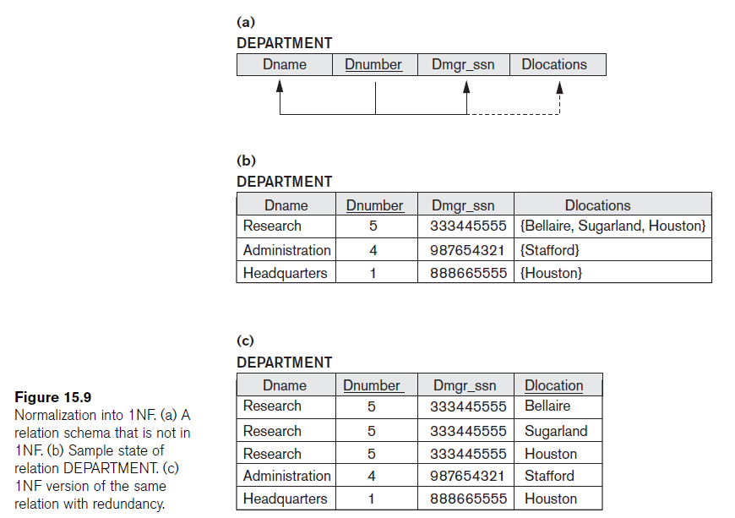
Figure 10.8 Normalization into 1NF
Note: The above figure is now called Figure 10.8 in Edition 4

Slide 182
3.3 Second Normal Form (1)
Uses the concepts of FDs, primary key
Definitions:
Prime attribute - attribute that is member of the primary key K
Full functional dependency - a FD Y -> Z where removal of any attribute from Y means the FD does not hold any more
Examples: - {SSN, PNUMBER} -> HOURS is a full FD since neither SSN -> HOURS nor PNUMBER -> HOURS hold
- {SSN, PNUMBER} -> ENAME is not a full FD (it is called a partial dependency ) since SSN -> ENAME also holds

Slide 183
Second Normal Form (2)
A relation schema R is in second normal form (2NF) if every non-prime attribute A in R is fully functionally dependent on the primary key
R can be decomposed into 2NF relations via the process of 2NF normalization

Slide 184
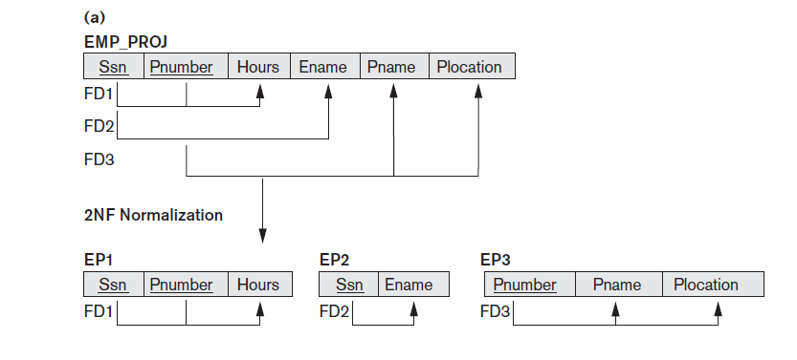

Slide 185
3.4 Third Normal Form (1)
Definition:
Transitive functional dependency - a FD X -> Z that can be derived from two FDs X -> Y and Y -> Z
Examples:
- SSN -> DMGRSSN is a transitive FD since
SSN -> DNUMBER and DNUMBER -> DMGRSSN hold
- SSN -> ENAME is non-transitive since there is no set of attributes X where SSN -> X and X -> ENAME

Slide 186
Third Normal Form (2)
A relation schema R is in third normal form (3NF) if it is in 2NF and no non-prime attribute A in R is transitively dependent on the primary key
R can be decomposed into 3NF relations via the process of 3NF normalization
NOTE:
In X -> Y and Y -> Z, with X as the primary key, we consider this a problem only if Y is not a candidate key. When Y is a candidate key, there is no problem with the transitive dependency .
E.g., Consider EMP (SSN, Emp#, Salary ).
Here, SSN -> Emp# -> Salary and Emp# is a candidate key.

Slide 187
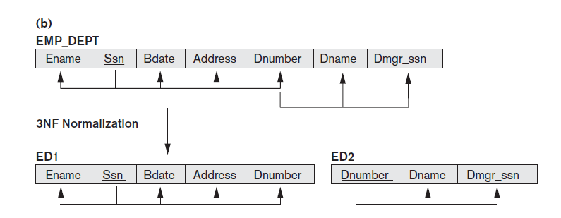

Slide 188
BCNF (Boyce-Codd Normal Form)
A relation schema R is in Boyce-Codd Normal Form (BCNF) if whenever an FD X -> A holds in R, then X is a superkey of R
Each normal form is strictly stronger than the previous one
Every 2NF relation is in 1NF
Every 3NF relation is in 2NF
Every BCNF relation is in 3NF
There exist relations that are in 3NF but not in BCNF
The goal is to have each relation in BCNF (or 3NF)

Slide 189
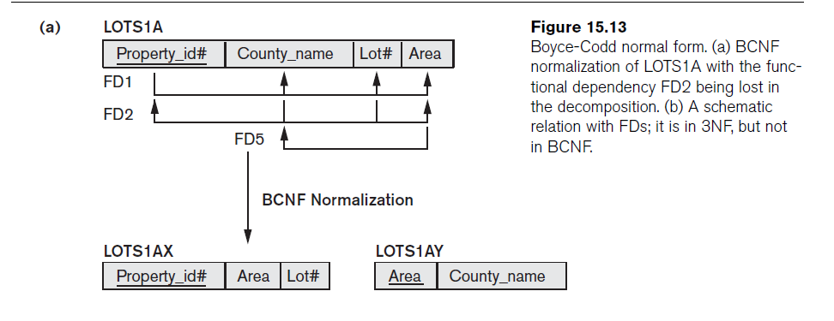
Figure 10.12 Boyce-Codd normal form
Note: The above figure is now called Figure 10.12 in Edition 4

Slide 190
MODULE-4

Slide 191
1.Introduction to Transaction Processing:-
1.1 Single-User versus Multiuser Systems
A DBMS is single-user if at most one user at
a time can use the system, and it is multiuser if many users can use the system—and hence access the database— concurrently.
Single-user DBMSs are mostly restricted to personal computer systems; most other DBMSs are multiuser.
For example, an airline reservations system is used by hundreds of travel agents and reservation clerks concurrently.

Slide 192
Multiple users can access databases simultaneously
because of the concept of multiprogramming, which allows the operating system of the computer to execute multiple programs—or processes—at the same time
A single central processing unit (CPU) can only execute at most one process at a time.
However, multiprogramming operating systems execute some commands from one process, then suspend that process and execute some commands from the nextprocess, and so on.
A process is resumed at the point where it was suspended whenever it gets its turn to use the CPU again. Hence, concurrent execution of processes
is actually interleaved

Slide 193
If the computer system has multiple hardware processors (CPUs), parallel processing
of multiple processes is possible, as illustrated by processes C and D in Figure21.1.Most of the theory concerning concurrency control in databases is developed in terms of interleaved concurrency

Slide 194
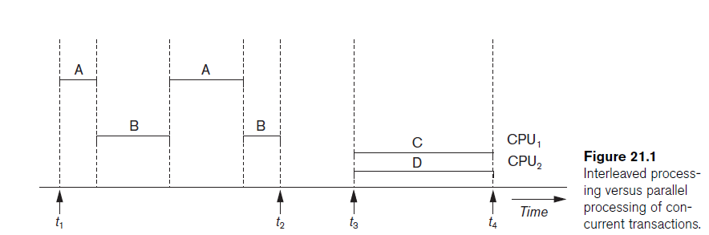

Slide 195
Transactions, Read and Write Operations, and DBMS Buffers
A transaction is an executing program that forms a logical unit of database processing.
A transaction includes one or more database access operations—these can include insertion, deletion, modification, or retrieval operations
One way of specifying the transaction boundaries is by specifying explicit begin transaction and end transaction statements in an application program
In this case, all database access operations between the two are considered as forming one transaction.

Slide 196
If the database operations in a transaction do not update the database but only retrieve data, the transaction is called a read-only transaction; otherwise it is known as a read-write transaction.
Using this simplified database model, the basic database access operations that a transaction can include are as follows:
■ read_item(X). Reads a database item named X into a program variable. To simplify our notation, we assume that the program variable is also named X.
■ write_item(X). Writes the value of program variable X into the database item named X.

Slide 197
The DBMS will maintain in the database cache a number of data buffers in main memory. Each buffer typically holds the contents of one database disk block, which contains some of the database items being processed
The read-set of a transaction is the set of all items that the transaction reads, and the write-set is the set of all items that the transaction writes. For example, the read-set of T1 in Figure 21.2 is {X, Y} and its write-set is also {X, Y}.

Slide 198
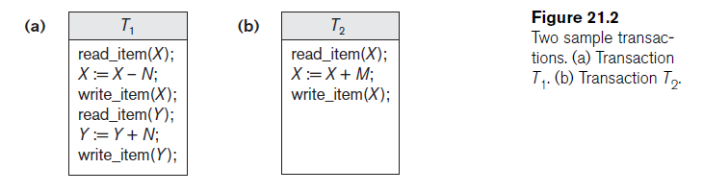
Why Concurrency Control Is Needed
Consider the ex: of airline reservation system
With following transaction

Slide 199
The Lost Update Problem:. This problem occurs when two transactions that access the same database items have their operations interleaved in a way that makes the value of some database items incorrect.
Figure 21.3(a); then the final value of item X is incorrect
because T2 reads the value of X before T1 changes it in the database, and hence the updated value resulting from T1 is lost.
For example, if X = 80 at the start (originally there were 80 reservations on the flight),N = 5 (T1 transfers 5 seat reservations from the flight corresponding to X to the flight corresponding to Y), and M = 4 (T2 reserves 4 seats on X), the final result should be X = 79.
However, in the interleaving of operations shown in Figure 21.3(a), it is X = 84 because the update in T1 that
removed the five seats from X was lost.

Slide 200
The Temporary Update (or Dirty Read) Problem.
This problem occurs when one transaction updates a database item and then the transaction fails for some reason
.Meanwhile, the updated item is accessed (read) by another transaction before it is changed back to its original value.
Figure 21.3(b) shows an example where T1 updates item X and then fails before completion, so the system must change X back to its original value.
Before it can do so, however, transaction T2 reads the temporary value of X, which will not be recorded permanently in the database
because of the failure of T1.
The value of item X that is read by T2 is called dirty data because it has been created by a transaction that has not completed and committed yet; hence, this problem is also known as the dirty read problem.

Slide 201
The Incorrect Summary Problem. If one transaction is calculating an aggregate summary function on a number of database items while other transactions are updating some of these items, the aggregate function may calculate some values before they are updated and others after they are updated.
For example, suppose that a transaction T3 is calculating the total number of reservations on all the flights;meanwhile, transaction T1 is executing.
If the interleaving of operations shown in Figure 21.3(c) occurs, the result of T3 will be off by an amount N because T3 reads the value of X after N seats have been subtracted from it but reads the value of Y
before those N seats have been added to it.

Slide 202
The Unrepeatable Read Problem. Another problem that may occur is called unrepeatable read, where a transaction T reads the same item twice and the item is
changed by another transaction T between the two reads.
Hence, T receives different values for its two reads of the same item. This may occur, for example, if during an airline reservation transaction, a customer inquires about seat availability on several flights.
When the customer decides on a particular flight, the transaction then reads the number of seats on that flight a second time before completing the reservation, and it may end up reading a different value for the item.

Slide 203
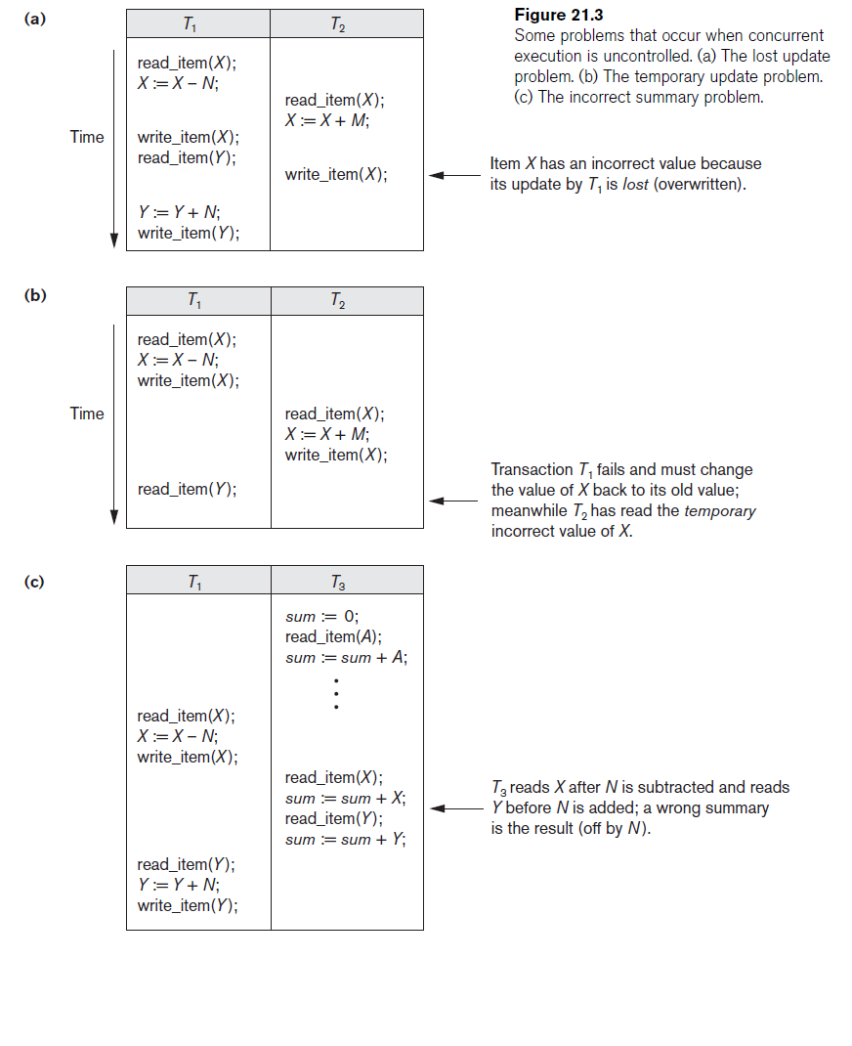

Slide 204
Why Recovery Is Needed
Whenever a transaction is submitted to a DBMS for execution, the system is responsible
for making sure that either all the operations in the transaction are completed successfully and their effect is recorded permanently in the database,-commited
The transaction does not have any effect on the database or any other transactions-aborted
If a transaction fails after executing some of its operations but before executing all of them, the operations already executed must be undone and have no lasting effect.

Slide 205
Types of Failures
1. A computer failure (system crash). A hardware, software, or network error occurs in the computer system during transaction execution. Hardware crashes are usually media failures—for example, main memory failure.
2. A transaction or system error. Some operation in the transaction may cause it to fail, such as integer overflow or division by zero. Transaction failure may also occur because of erroneous parameter values or because of a logical programming error. Additionally, the user may interrupt the transaction during its execution.
3. Local errors or exception conditions detected by the transaction. During transaction execution, certain conditions may occur that necessitate cancellation found. An exception condition, such as insufficient account balance in banking database, may cause a transaction, such as a fund withdrawal, to be canceled. This exception could be programmed in the transaction itself, and in such a case would not be considered as a transaction failure.

Slide 206
4. Concurrency control enforcement. The concurrency control method may decide to abort a transaction because it violates serializability, or it may abort one or more transactions to resolve a state of deadlock among several transactions .Transactions aborted because of serializability violations or deadlocks are typically restarted automatically at a later time.
5. Disk failure. Some disk blocks may lose their data because of a read or write malfunction or because of a disk read/write head crash. This may happen during a read or a write operation of the transaction.
6. Physical problems and catastrophes. This refers to an endless list of problems that includes power or air-conditioning failure, fire, theft, sabotage,overwriting disks or tapes by mistake, and mounting of a wrong tape by the operator.

Slide 207
Transaction and System Concepts
A transaction is an atomic unit of work that should either be completed in its entirety or not done at all.
For recovery purposes, the system needs to keep track of when each transaction starts, terminates, and commits or aborts
■ BEGIN_TRANSACTION. This marks the beginning of transaction execution.
■ READ or WRITE. These specify read or write operations on the database items that are executed as part of a transaction.
■ END_TRANSACTION. This specifies that READ and WRITE transaction operations have ended and marks the end of transaction execution. However, at this point it may be necessary to check whether the changes introduced by

Slide 208
the transaction can be permanently applied to the database (committed) or whether the transaction has to be aborted because it violates serializability or for some other reason.
■ COMMIT_TRANSACTION. This signals a successful end of the transaction so that any changes (updates) executed by the transaction can be safely committed to the database and will not be undone.
■ ROLLBACK (or ABORT). This signals that the transaction has ended unsuccessfully,so that any changes or effects that the transaction may have applied to the database must be undone.

Slide 209
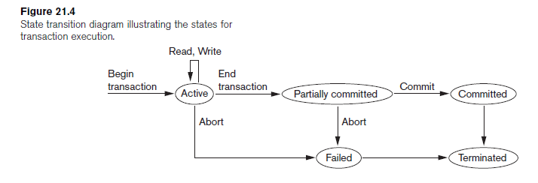

Slide 210
Desirable Properties of Transactions
Transactions should possess several properties, often called the ACID properties
■ Atomicity. A transaction is an atomic unit of processing; it should either be performed in its entirety or not performed at all.
■ Consistency preservation. A transaction should be consistency preserving,meaning that if it is completely executed from beginning to end without interference from other transactions, it should take the database from one consistent state to another.
■ Isolation. A transaction should appear as though it is being executed in isolation from other transactions, even though many transactions are executing concurrently. That is, the execution of a transaction should not be interfered with by any other transactions executing concurrently.
■ Durability or permanency. The changes applied to the database by a committed transaction must persist in the database. These changes must not be lost because of any failure.

Slide 211
Schedules (Histories) of Transactions
A schedule (or history) S of n transactions T1, T2, ..., Tn is an ordering of the operations of the transactions.
Operations from different transactions can be interleaved in the schedule S.
The order of operations in S is considered to be a total ordering, meaning that for any two operations in the schedule, one must occur before the other.
. A shorthand notation for describing a schedule uses the symbols b, r, w, e, c, and a for the operations begin_transaction, read_item, write_item, end_transaction,commit, and abort, respectively,

Slide 212
For example, the schedule in Figure21.3(a), 21.3(b)which we shall call Sa,sb can be written as follows in this notation:
Sa: r1(X); r2(X); w1(X); r1(Y); w2(X); w1(Y);
Sb: r1(X); w1(X); r2(X); w2(X); r1(Y); a1;
Two operations in a schedule are said to conflict if they satisfy all three of the following conditions:
(1) they belong to different transactions;
(2) they access the same item X; and
(3) at least one of the operations is a write_item(X).

Slide 213
r1(X);w2(X) to w2(X); r1(X),-read-write conflict
w1(X); w2(X) to w2(X);w1(X).-write-write conflict
A schedule S of n transactions T1, T2, ..., Tn is said to be a complete schedule if the following conditions hold:
1. The operations in S are exactly those operations in T1, T2, ..., Tn, including a commit or abort operation as the last operation for each transaction in the schedule.
2. For any pair of operations from the same transaction Ti, their relative order of appearance in S is the same as their order of appearance in Ti.
3. For any two conflicting operations, one of the two must occur before the other in the schedule.

Slide 214
once a transaction T is committed, it should never be necessary to roll back T. This ensures that the durability property of transactions is not violated are called recoverable schedules; those that do not are called nonrecoverable.
The definition of recoverable schedule is as follows: A schedule S is recoverable if no transaction T in S commits until all transactions T that have written some item X that T reads have committed. A transaction T reads from transaction T in a schedule S if some item
X is first written by T and later read by T. In addition, T should not have been aborted before T reads item X, and there should be no transactions that write X after
T writes it and before T reads it

Slide 215
Sa: r1(X); r2(X); w1(X); r1(Y); w2(X); c2; w1(Y); c1;
Sc: r1(X); w1(X); r2(X); r1(Y); w2(X); c2; a1;
Sd: r1(X); w1(X); r2(X); r1(Y); w2(X); w1(Y); c1; c2;
Se: r1(X); w1(X); r2(X); r1(Y); w2(X); w1(Y); a1; a2;
Sa is recoverable, Sc is not recoverable
cascading rollback (or cascading abort) to occur in some recoverable schedules, where an uncommitted transaction has to be rolled back because it read an item from a transaction that failed. Because cascading rollback can be quite time-consuming—since numerous transactions can be rolled back .ex:se

Slide 216
A schedule is said to be cascadeless, or to avoid cascading rollback, if every transaction in the schedule reads only items that were written by committed transactions. In this case, all items read will not be discarded, so no cascading rollback will occur.
a strict schedule, in which transactions can neither read nor write an item X until the last transaction that
wrote X has committed (or aborted).
Strict schedules simplify the recovery process.
In a strict schedule, the process of undoing a write_item(X) operation of an aborted transaction is simply to restore the before image (old_value or BFIM) of data item X

Slide 217
Serial, Nonserial, and Conflict-Serializable Schedules
Schedules A and B in Figure 21.5(a) and (b) are called serial because the operations of each transaction are executed consecutively, without any interleaved operations from the other transaction.
In a serial schedule, entire transactions are performed in serial order: T1 and then T2 in Figure 21.5(a), and T2 and then T1 in Figure 21.5(b).
Schedules C and D in Figure 21.5(c) are called nonserial because each sequence interleaves operations from the two transactions.

Slide 218
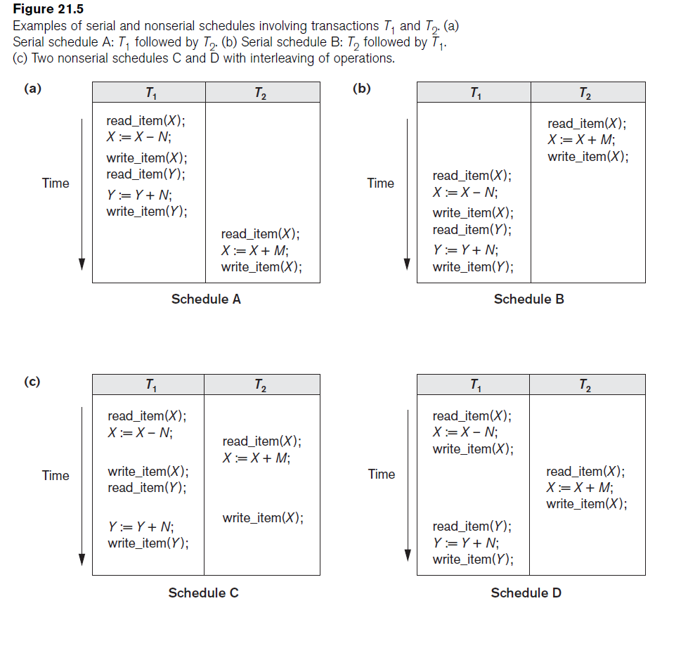

Slide 219
Disadvantage of serial schedule
The problem with serial schedules is that they limit concurrency by prohibiting interleaving of operations.
In a serial schedule, if a transaction waits for an I/O
operation to complete, we cannot switch the CPU processor to another transaction, thus wasting valuable CPU processing time.
Additionally, if some transaction T is quite long, the other transactions must wait for T to complete all its operations before starting.
Hence, serial schedules are considered unacceptable in practice.

Slide 220
serializable schedule
A schedule S of n transactions is serializable if it is equivalent to some serial schedule of the same n transactions
there are n! possible serial schedules of n transactions
two schedules to be equivalent, the operations applied to each data item affected by the schedules should be applied to that item in both schedules in the same order.
Two definitions of equivalence of schedules are generally used: conflict equivalence and view equivalence.

Slide 221
Two schedules are said to be conflict equivalent if the order of any two conflicting operations is the same in both schedules.
two operations in a schedule are said to conflict if they belong to different transactions, access the same database
item, and either both are write_item operations or one is a write_item and the other a read_item.
If two conflicting operations are applied in different orders in two schedules, the effect can be different on the database or on the transactions in the schedule,and hence the schedules are not conflict equivalent

Slide 222
Schedule1 schedule2 shedule3
T1 T2 T1 T2 T1 T2
R(x) w(x) R(x)
w(x)
R(x)
w(x) w(y)
R(Y) R(Y)
w(y) R(Y)
w(Y)
here shedule1 and shedule3 are conflict serializable

Slide 223
Testing for Conflict Serializability of a Schedule
The algorithm looks at only the read_item and write_item operations in a schedule to construct
a precedence graph (or serialization graph), which is a directed graph G = (N, E) that consists of a set of nodes N = {T1, T2, ..., Tn } and a set of directed edges E = {e1,
e2, ..., em }.
There is one node in the graph for each transaction Ti in the schedule.
Each edge ei in the graph is of the form (Tj→Tk ), 1 ≤ j ≤ n, 1 ≤ k 􀁦 n, where Tj is the starting node of ei and Tk is the ending node of ei. Such an edge from node Tj to

Slide 224
node Tk is created by the algorithm if one of the operations in Tj appears in the schedule before some conflicting operation in Tk.
Algorithm 21.1. Testing Conflict Serializability of a Schedule S
1. For each transaction Ti participating in schedule S, create a node labeled Ti in the precedence graph.
2. For each case in S where Tj executes a read_item(X) after Ti executes a write_item(X), create an edge (Ti→ Tj) in the precedence graph.
3. For each case in S where Tj executes a write_item(X) after Ti executes a read_item(X), create an edge (Ti→Tj) in the precedence graph.
4. For each case in S where Tj executes a write_item(X) after Ti executes a write_item(X), create an edge (Ti→ Tj) in the precedence graph.
5. The schedule S is serializable if and only if the precedence graph has no cycles.

Slide 225
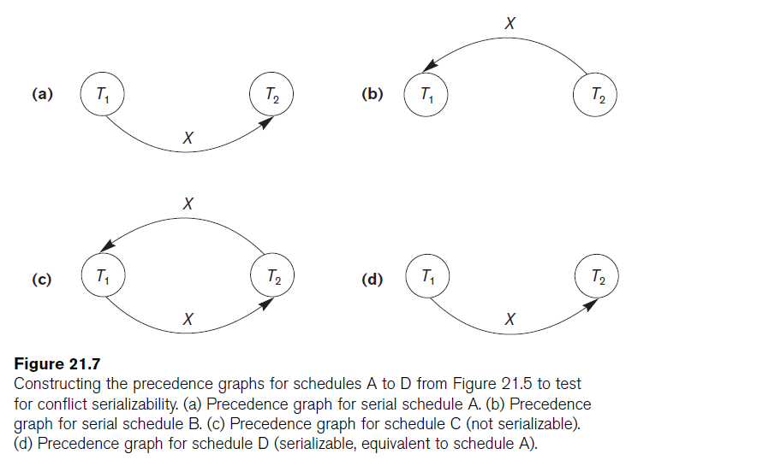

Slide 226
View Equivalence and View Serializability
Two schedules S and S are said to be view equivalent if the following three conditions hold:
1. The same set of transactions participates in S and S, and S and S include the same operations of those transactions.
2. For any operation ri(X) of Ti in S, if the value of X read by the operation has been written by an operation wj(X) of Tj (or if it is the original value of X before the schedule started), the same condition must hold for the value of X read by operation ri(X) of Ti in S.
3. If the operation wk(Y) of Tk is the last operation to write item Y in S, then wk(Y) of Tk must also be the last operation to write item Y in S

Slide 227
Schedule1 schedule2 shedule3
T1 T2 T1 T2 T1 T2
R(x) w(x) R(x)
w(y) R(y)
R(x)
w(x) R(Y)
R(Y) W(x)
w(y)
W(Y)
here shedule1 and shedule3 are view serializable

Slide 228
Database Concurrency Control
1 Purpose of Concurrency Control
To enforce Isolation (through mutual exclusion) among conflicting transactions.
To preserve database consistency through consistency preserving execution of transactions.
To resolve read-write and write-write conflicts.
Example: In concurrent execution environment if T₁ conflicts with T₂ over a data item A, then the existing concurrency control decides if T₁ or T₂ should get the A and if the other transaction is rolled-back or waits.

Slide 229
Database Concurrency Control
Two-Phase Locking Techniques
Locking is an operation which secures (a) permission to Read or (b) permission to Write a data item for a transaction. Example: Lock(X). Data item X is locked in behalf of the requesting transaction.
Unlocking is an operation which removes these permissions from the data item. Example: Unlock(X). Data item X is made available to all other transactions.
Lock and Unlock are atomic operations.

Slide 230
Database Concurrency Control
Two-Phase Locking Techniques: Essential components
Two locks modes (a) shared (read) and (b) exclusive (write).
Shared mode: shared lock (X). More than one transaction can apply share lock on X for reading its value but no write lock can be applied on X by any other transaction.
Exclusive mode: Write lock (X). Only one write lock on X can exist at any time and no shared lock can be applied by any other transaction on X.
Conflict matrix

Slide 231
Database Concurrency Control
Two-Phase Locking Techniques: Essential components
Lock Manager: Managing locks on data items.
Lock table: Lock manager uses it to store the identity of transaction locking (the data item, lock mode and pointer to the next data item locked). One simple way to implement a lock table is through linked list.

Slide 232
Database Concurrency Control
Two-Phase Locking Techniques: Essential components
Database requires that all transactions should be well-formed. A transaction is well-formed if:
It must lock the data item before it reads or writes to it.
It must not lock an already locked data items and it must not try to unlock a free data item.

Slide 233
Database Concurrency Control
Two-Phase Locking Techniques: Essential components
The following code performs the lock operation:
B: if LOCK (X) = 0 (*item is unlocked*)
then LOCK (X) ← 1 (*lock the item*)
else begin
wait (until lock (X) = 0) and
the lock manager wakes up the transaction);
goto B
end;

Slide 234
Database Concurrency Control
Two-Phase Locking Techniques: Essential components
The following code performs the unlock operation:
LOCK (X) ← 0 (*unlock the item*)
if any transactions are waiting then
wake up one of the waiting the transactions;

Slide 235
Database Concurrency Control
Two-Phase Locking Techniques: Essential components
The following code performs the read operation:
B: if LOCK (X) = “unlocked” then
begin LOCK (X) ← “read-locked”;
no_of_reads (X) ← 1;
end
else if LOCK (X) ← “read-locked” then
no_of_reads (X) ← no_of_reads (X) +1
else begin wait (until LOCK (X) = “unlocked” and
the lock manager wakes up the transaction);
go to B
end;

Slide 236
Database Concurrency Control
Two-Phase Locking Techniques: Essential components
The following code performs the write lock operation:
B: if LOCK (X) = “unlocked” then
LOCK (X) ← “write-locked”;
else begin
wait (until LOCK (X) = “unlocked” and
the lock manager wakes up the transaction);
go to B
end;

Slide 237
Database Concurrency Control
Two-Phase Locking Techniques: Essential components
The following code performs the unlock operation:
if LOCK (X) = “write-locked” then
begin LOCK (X) ← “unlocked”;
wakes up one of the transactions, if any
end
else if LOCK (X) ← “read-locked” then
begin
no_of_reads (X) ← no_of_reads (X) -1
if no_of_reads (X) = 0 then
begin
LOCK (X) = “unlocked”;
wake up one of the transactions, if any
end
end;

Slide 238
When we use the share/exclusive locking scheme, the system must enforce the following rules:
1. A transaction T must issue the operation read_lock(X) or write_lock(X) before any read_item(X) operation is performed in T.
2. A transaction T must issue the operation write_lock(X) before any write_item(X) operation is performed in T.
3. A transaction T must issue the operation unlock(X) after all read_item(X) and write_item(X) operations are completed in T.
4. A transaction T must not issue a read_lock(X) operation if it already holds a read(shared) lock or a write(exclusive) lock on item X.
5. A transaction T must not issue a write_lock(X) operation if it already holds a read(shared) lock or a write(exclusive) lock on item X.
6. A transaction T must not issue the operation unlock(X) unless it already holds a read (shared) lock or a write(exclusive) lock on item X.

Slide 239
Database Concurrency Control
Two-Phase Locking Techniques: Essential components
Lock conversion
Lock upgrade: existing read lock to write lock
if T_{i} has a read-lock (X) and T_{j} has no read-lock (X) (i ≠ j) then
convert read-lock (X) to write-lock (X)
else
force T_{i} to wait until T_{j} unlocks X
Lock downgrade: existing write lock to read lock
T_{i} has a write-lock (X) (*no transaction can have any lock on X*)
convert write-lock (X) to read-lock (X)

Slide 240
Database Concurrency Control
Two-Phase Locking Techniques: The algorithm
Two Phases: (a) Locking (Growing) (b) Unlocking (Shrinking).
Locking (Growing) Phase: A transaction applies locks (read or write) on desired data items one at a time.
Unlocking (Shrinking) Phase: A transaction unlocks its locked data items one at a time.
Requirement: For a transaction these two phases must be mutually exclusively, that is, during locking phase unlocking phase must not start and during unlocking phase locking phase must not begin.

Slide 241
Database Concurrency Control
Two-Phase Locking Techniques: The algorithm
T1 T2 Result
read_lock (Y); read_lock (X); Initial values: X=20; Y=30
read_item (Y); read_item (X); Result of serial execution
unlock (Y); unlock (X); T₁ followed by T₂
write_lock (X); Write_lock (Y); X=50, Y=80.
read_item (X); read_item (Y); Result of serial execution
X:=X+Y; Y:=X+Y; T₂ followed by T₁
write_item (X); write_item (Y); X=70, Y=50
unlock (X); unlock (Y);

Slide 242
Database Concurrency Control
Two-Phase Locking Techniques: The algorithm
T1 T2 Result
read_lock (Y); X=50; Y=50
read_item (Y); Nonserializable because it.
unlock (Y); violated two-phase policy.
read_lock (X);
read_item (X);
unlock (X);
write_lock (Y);
read_item (Y);
Y:=X+Y;
write_item (Y);
unlock (Y);
write_lock (X);
read_item (X);
X:=X+Y;
write_item (X);
unlock (X);
Time

Slide 243
Database Concurrency Control
Two-Phase Locking Techniques: The algorithm
T’1 T’2
read_lock (Y); read_lock (X); T₁ and T₂ follow two-phase
read_item (Y); read_item (X); policy but they are subject to
write_lock (X); write_lock (Y); deadlock, which must be
unlock (Y); unlock (X); dealt with.
read_item (X); read_item (Y);
X:=X+Y; Y:=X+Y;
write_item (X); write_item (Y);
unlock (X); unlock (Y);

Slide 244
Database Concurrency Control
Two-Phase Locking Techniques: The algorithm
Two-phase policy generates two locking algorithms (a) Basic and (b) Conservative.
Conservative: Prevents deadlock by locking all desired data items before transaction begins execution.
Basic: Transaction locks data items incrementally. This may cause deadlock which is dealt with.
Strict: A more stricter version of Basic algorithm where unlocking is performed after a transaction terminates (commits or aborts and rolled-back). This is the most commonly used two-phase locking algorithm.

Slide 245
Database Concurrency Control
Dealing with Deadlock and Starvation
Deadlock
T’₁ T’₂
read_lock (Y); T’₁ and T’₂ did follow two-phase
read_item (Y); policy but they are deadlock
read_lock (X);
read_item (Y);
write_lock (X);
(waits for X) write_lock (Y);
(waits for Y)
Deadlock (T’₁ and T’₂)

Slide 246
Database Concurrency Control
Dealing with Deadlock and Starvation
Deadlock prevention
A transaction locks all data items it refers to before it begins execution. This way of locking prevents deadlock since a transaction never waits for a data item. The conservative two-phase locking uses this approach.

Slide 247
Database Concurrency Control
Dealing with Deadlock and Starvation
Deadlock detection and resolution
In this approach, deadlocks are allowed to happen. The scheduler maintains a wait-for-graph for detecting cycle. If a cycle exists, then one transaction involved in the cycle is selected (victim) and rolled-back.
A wait-for-graph is created using the lock table. As soon as a transaction is blocked, it is added to the graph. When a chain like: T_{i} waits for T_{j} waits for T_{k} waits for T_{i} or T_{j} occurs, then this creates a cycle. One of the transaction of the cycle is selected and rolled back.

Slide 248
Wait-for graph
T’₁ T’₂
read_lock (Y); read_item (Y); read_lock (X);
read_item (Y);
write_lock (X);
(waits for X) write_lock (Y);
(waits for Y)
T’₁
T’₂
b) wait-for graph
a) Partial schedule of T’₁ and T’₂

Slide 249
Database Concurrency Control
Dealing with Deadlock and Starvation
Deadlock avoidance
There are many variations of two-phase locking algorithm. Some avoid deadlock by not letting the cycle to complete. That is as soon as the algorithm discovers that blocking a transaction is likely to create a cycle, it rolls back the transaction. Wound-Wait and Wait-Die algorithms use timestamps to avoid deadlocks by rolling-back victim.

Slide 250
Database Concurrency Control
Dealing with Deadlock and Starvation
Starvation
Starvation occurs when a particular transaction consistently waits or restarted and never gets a chance to proceed further. In a deadlock resolution it is possible that the same transaction may consistently be selected as victim and rolled-back. This limitation is inherent in all priority based scheduling mechanisms. In Wound-Wait scheme a younger transaction may always be wounded (aborted) by a long running older transaction which may create starvation.

Slide 251
Database Concurrency Control
Timestamp based concurrency control algorithm
Timestamp
A monotonically increasing variable (integer) indicating the age of an operation or a transaction. A larger timestamp value indicates a more recent event or operation.
Timestamp-based algorithm uses timestamp to serialize the execution of concurrent transactions.

Slide 252
Timestamps
The algorithm associates with each database item X with two timestamp (TS) values:
Read_TS(X): The read timestamp of item X; this is the largest timestamp among all the timestamps of transactions that have successfully read item X.
Write_TS(X):The write timestamp of item X; this is the largest timestamp among all the timestamps of transactions that have successfully written item X.

Slide 253
Database Concurrency Control
Timestamp based concurrency control algorithm
Basic Timestamp Ordering
1. Transaction T issues a write_item(X) operation:
If read_TS(X) > TS(T) or if write_TS(X) > TS(T), then an younger transaction has already read the data item so abort and roll-back T and reject the operation.
If the condition in part (a) does not exist, then execute write_item(X) of T and set write_TS(X) to TS(T).
2. Transaction T issues a read_item(X) operation:
If write_TS(X) > TS(T), then an younger transaction has already written to the data item so abort and roll-back T and reject the operation.
If write_TS(X) ≤ TS(T), then execute read_item(X) of T and set read_TS(X) to the larger of TS(T) and the current read_TS(X).

Slide 254
Ex:Three transactions executing under a timestamp-based scheduler
T1 | T2 | T3 | A | B | C
200 | 150 | 175 | RT =0 WT=0 | RT = 0 WT=0 | RT=0 WT=0
r1(B) w1(B) w1(A) | r2(A) w2(C) Abort | r3(C) w3(A) | RT = 150 WT=200 | RT = 200 WT=200 | RT=175
Why T2 must be aborted (rolled-back)?

Slide 255
Database Concurrency Control
Timestamp based concurrency control algorithm
Strict Timestamp Ordering
1. Transaction T issues a write_item(X) operation:
If TS(T) > read_TS(X), then delay T until the transaction T’ that wrote or read X has terminated (committed or aborted).
2. Transaction T issues a read_item(X) operation:
If TS(T) > write_TS(X), then delay T until the transaction T’ that wrote or read X has terminated (committed or aborted).

Slide 256
Database Concurrency Control
Timestamp based concurrency control algorithm
Thomas’s Write Rule
If read_TS(X) > TS(T) then abort and roll-back T and reject the operation.
If write_TS(X) > TS(T), then just ignore the write operation and continue execution. This is because the most recent writes counts in case of two consecutive writes.
If the conditions given in 1 and 2 above do not occur, then execute write_item(X) of T and set write_TS(X) to TS(T).

Slide 257
Database Concurrency Control
Multiversion concurrency control techniques
Concept
This approach maintains a number of versions of a data item and allocates the right version to a read operation of a transaction. Thus unlike other mechanisms a read operation in this mechanism is never rejected.
Side effect: Significantly more storage (RAM and disk) is required to maintain multiple versions. To check unlimited growth of versions, a garbage collection is run when some criteria is satisfied.

Slide 258
Database Concurrency Control
Multiversion technique based on timestamp ordering
Assume X₁, X₂, …, X_{n} are the versions of a data item X created by a write operation of transactions. With each X_{i} a read_TS (read timestamp) and a write_TS (write timestamp) are associated.
read_TS(X_{i}): The read timestamp of X_{i} is the largest of all the timestamps of transactions that have successfully read version X_{i}.
write_TS(X_{i}): The write timestamp of X_{i} that wrote the value of version X_{i}.
A new version of X_{i} is created only by a write operation.

Slide 259
Database Concurrency Control
Multiversion technique based on timestamp ordering
To ensure serializability, the following two rules are used.
If transaction T issues write_item(X) and version i of X has the highest write_TS(X_{i}) of all versions of X that is also less than or equal to TS(T), and read _TS(X_{i}) > TS(T), then abort and roll-back T; otherwise create a new version X_{i} and read_TS(X) = write_TS(X_{j}) = TS(T).
If transaction T issues read_item (X), find the version i of X that has the highest write_TS(X_{i}) of all versions of X that is also less than or equal to TS(T), then return the value of X_{i} to T, and set the value of read _TS(X_{i}) to the largest of TS(T) and the current read_TS(X_{i}).
Rule 2 guarantees that a read will never be rejected.

Slide 260
Ex: Execution of transactions using multiversion concurrency control
T1 | T2 | T3 | T4 | A₀ | A₁₅₀ | A₂₀₀
150 | 200 | 175 | 225
r1(A) w1(A) | r2(A) w2(A) | r3(A) | r4(A) | read | Create Read read | Create read
Note: T3 does not have to abort, because it can read an earlier version of A.

Slide 261
Database Concurrency Control
Multiversion Two-Phase Locking Using Certify Locks
Concept
Allow a transaction T’ to read a data item X while it is write locked by a conflicting transaction T.
This is accomplished by maintaining two versions of each data item X where one version must always have been written by some committed transaction. This means a write operation always creates a new version of X.

Slide 262
Database Concurrency Control
Multiversion Two-Phase Locking Using Certify Locks
Steps
X is the committed version of a data item.
T creates a second version X’ after obtaining a write lock on X.
Other transactions continue to read X.
T is ready to commit so it obtains a certify lock on X’.
The committed version X becomes X’.
T releases its certify lock on X’, which is X now.
Compatibility tables for
read/write locking scheme read/write/certify locking scheme

Slide 263
Database Concurrency Control
Multiversion Two-Phase Locking Using Certify Locks
Note
In multiversion 2PL, read and write operations from conflicting transactions can be processed concurrently. This improves concurrency but it may delay transaction commit because of obtaining certify locks on all its writes. It avoids cascading abort but like strict two-phase locking scheme conflicting transactions may get deadlocked.

Slide 264
Database Concurrency Control
Validation (Optimistic) Concurrency Control Schemes
In this technique only at the time of commit serializability is checked and transactions are aborted in case of non-serializable schedules.
Three phases:
Read phase: A transaction can read values of committed data items. However, updates are applied only to local copies (versions) of the data items (in database cache).

Slide 265
Database Concurrency Control
Validation (Optimistic) Concurrency Control Schemes
Validation phase: Serializability is checked before transactions write their updates to the database.
This phase for T_{i} checks that, for each transaction T_{j} that is either committed or is in its validation phase, one of the following conditions holds:
T_{j} completes its write phase before T_{i} starts its read phase.
T_{i} starts its write phase after T_{j} completes its write phase, and the read_set of T_{i} has no items in common with the write_set of T_{j}
Both the read_set and write_set of T_{i} have no items in common with the write_set of T_{j}, and T_{j} completes its read phase.

Slide 266
Database Concurrency Control
Validation (Optimistic) Concurrency Control Schemes
When validating T_{i}, the first condition is checked first for each transaction T_{j}, since (1) is the simplest condition to check. If (1) is false then (2) is checked and if (2) is false then (3) is checked. If none of these conditions holds, the validation fails and T_{i} is aborted.
Write phase: On a successful validation transactions’ updates are applied to the database; otherwise, transactions are restarted.

Slide 267
Database Concurrency Control
Granularity of data items and Multiple Granularity Locking
A lockable unit of data defines its granularity. Granularity can be coarse (entire database) or it can be fine (a tuple or an attribute of a relation). Data item granularity significantly affects concurrency control performance. Thus, the degree of concurrency is low for coarse granularity and high for fine granularity. Example of data item granularity:
A field of a database record (an attribute of a tuple).
A database record (a tuple or a relation).
A disk block.
An entire file.
The entire database.

Slide 268
Database Concurrency Control
Granularity of data items and Multiple Granularity Locking
The following diagram illustrates a hierarchy of granularity from coarse (database) to fine (record).

Slide 269
Database Concurrency Control
Granularity of data items and Multiple Granularity Locking
To manage such hierarchy, in addition to read and write, three additional locking modes, called intention lock modes are defined:
Intention-shared (IS): indicates that a shared lock(s) will be requested on some descendent nodes(s).
Intention-exclusive (IX): indicates that an exclusive lock(s) will be requested on some descendent nodes(s).
Shared-intention-exclusive (SIX): indicates that the current node is locked in shared mode but an exclusive lock(s) will be requested on some descendent nodes(s).

Slide 270
Database Concurrency Control
Granularity of data items and Multiple Granularity Locking
These locks are applied using the following compatibility matrix:

Slide 271
Database Concurrency Control
Granularity of data items and Multiple Granularity Locking
The set of rules which must be followed for producing serializable schedule are
The lock compatibility must adhered to.
The root of the tree must be locked first, in any mode..
A node N can be locked by a transaction T in S or IX mode only if the parent node is already locked by T in either IS or IX mode.
A node N can be locked by T in X, IX, or SIX mode only if the parent of N is already locked by T in either IX or SIX mode.
T can lock a node only if it has not unlocked any node (to enforce 2PL policy).
T can unlock a node, N, only if none of the children of N are currently locked by T.

Slide 272
Database Concurrency Control
Granularity of data items and Multiple Granularity Locking
An example of a serializable execution:
T₁ T₂ T₃
IX(db)
IX(f₁)
IX(db)
IS(db)
IS(f₁)
IS(p₁₁)
IX(p₁₁)
X(r₁₁₁)
IX(f₁)
X(p₁₂)
S(r_{11j})
IX(f₂)
IX(p₂₁)
IX(r₂₁₁)
Unlock (r₂₁₁)
Unlock (p₂₁)
Unlock (f₂)
S(f₂)
T₁ want to update r₁₁₁, r₁₁₂
T₂ want to update page p₁₂
T₂ wants to update r_{11j} and f₂

Slide 273
Database Concurrency Control
Granularity of data items and Multiple Granularity Locking
An example of a serializable execution (continued):
T₁ T₂ T₃
unlock(p₁₂)
unlock(f₁)
unlock(db)
unlock(r₁₁₁)
unlock(p₁₁)
unlock(f₁)
unlock(db)
unlock (r_{111j})
unlock (p₁₁)
unlock (f₁)
unlock(f₂)
unlock(db)

